Slide 1



SentinelOne Connector Launch
Fortinet Fabric Ready Partner
Co-Joining the Endpoint and the Network

Slide 2

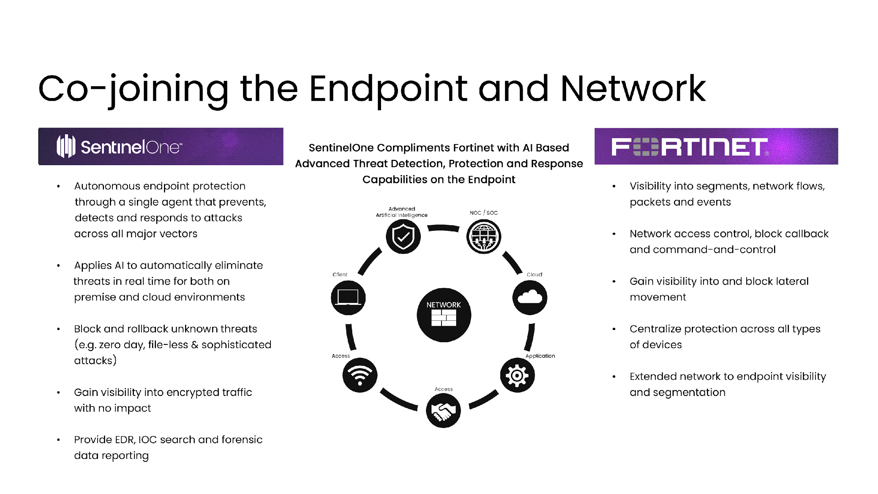
Advanced Artificial Intelligence
NOC/SOC
Client
Cloud
Access
Application
Access

Slide 3
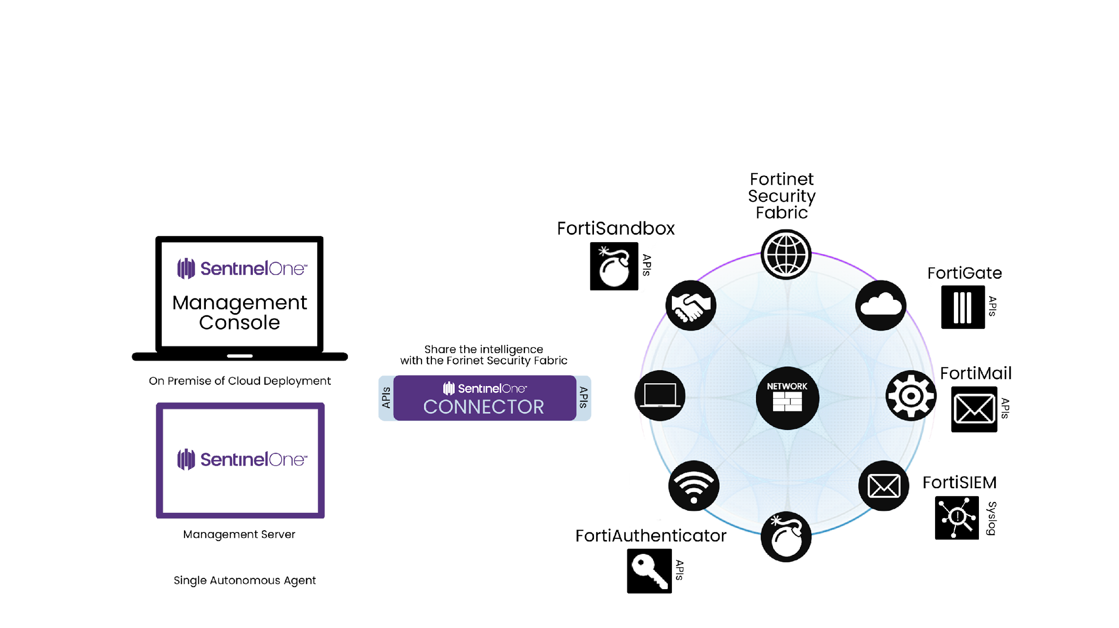


Slide 4


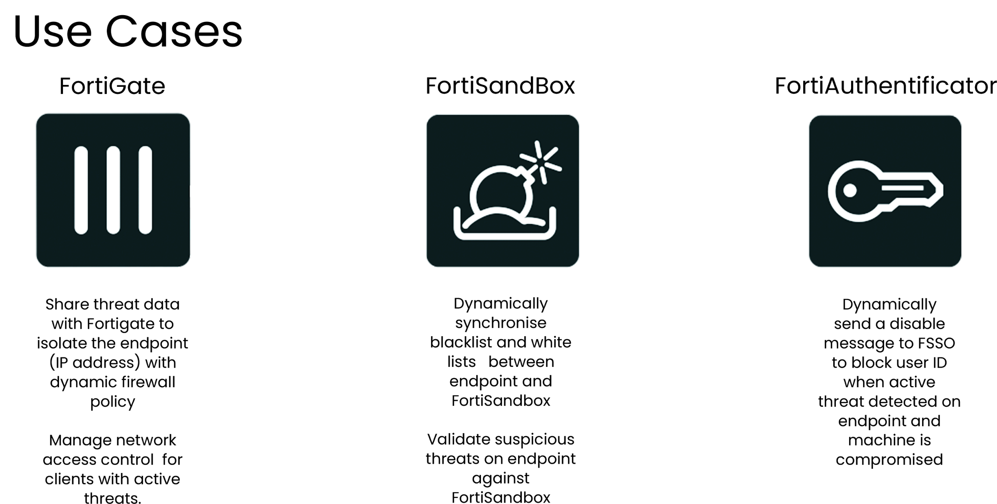

Slide 5
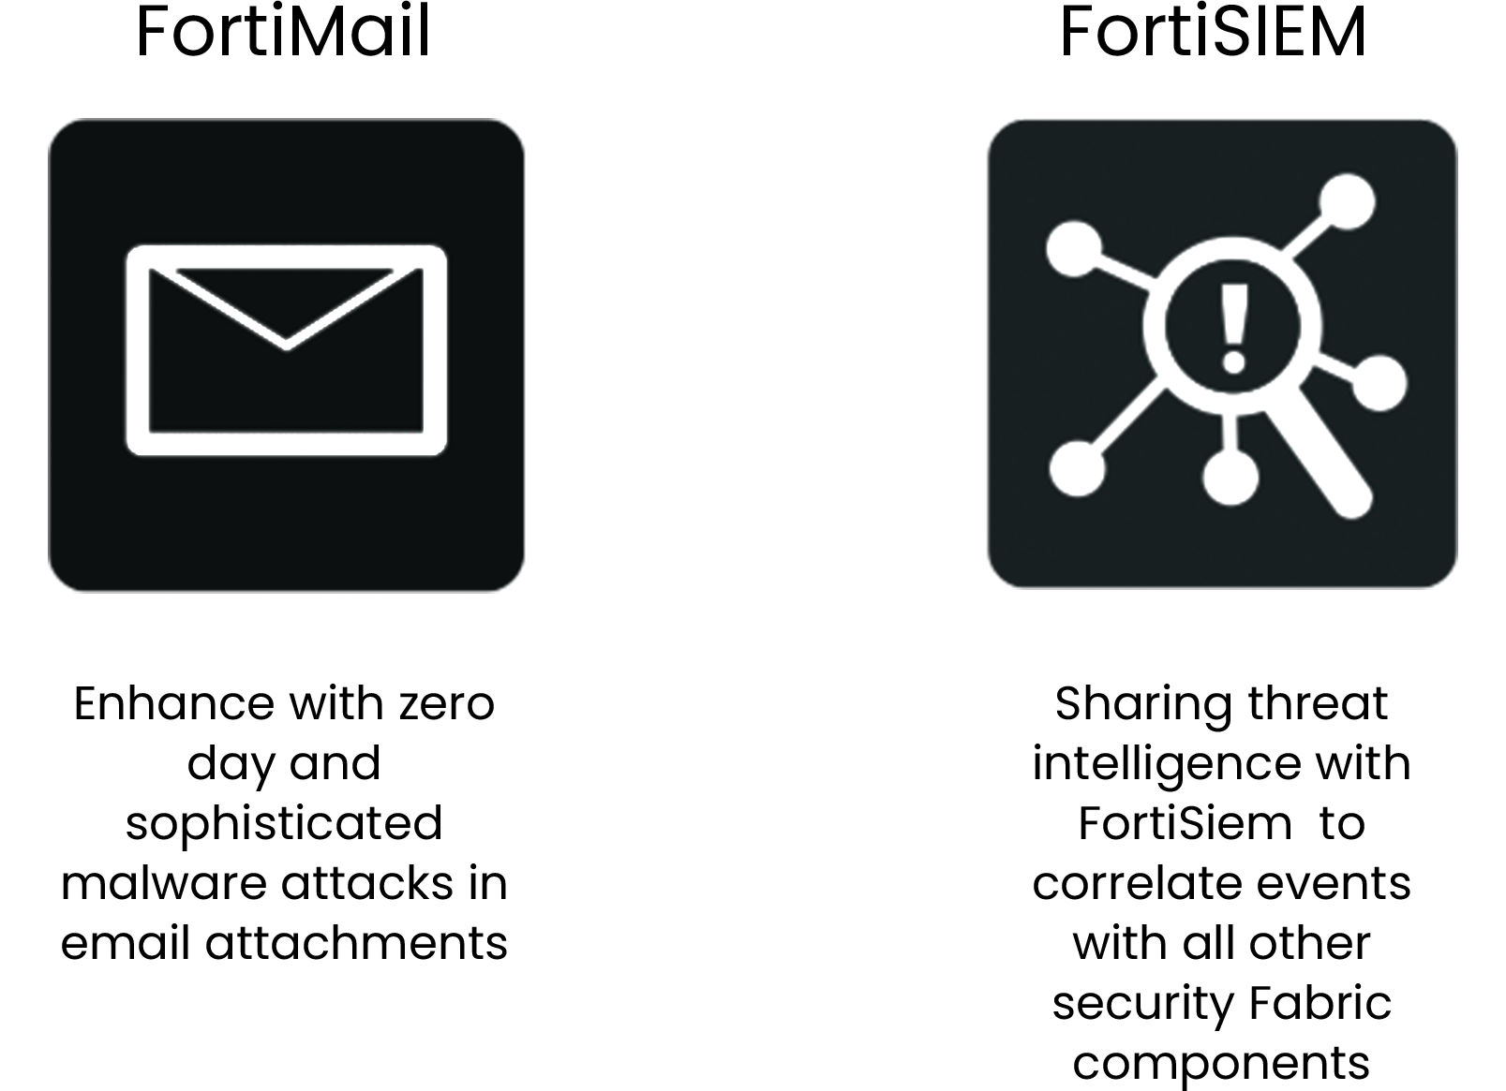

Slide 6
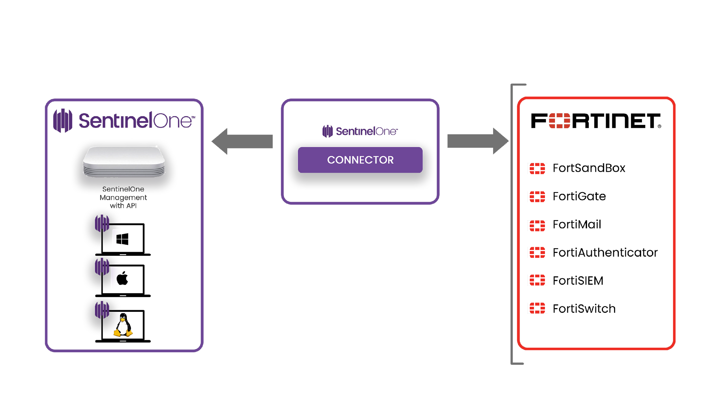

© 2018 SentinelOne All Rights Reserved. Confidential

Slide 7
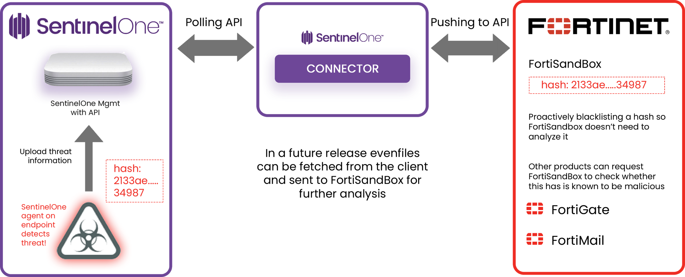

© 2018 SentinelOne All Rights Reserved. Confidential

Slide 8
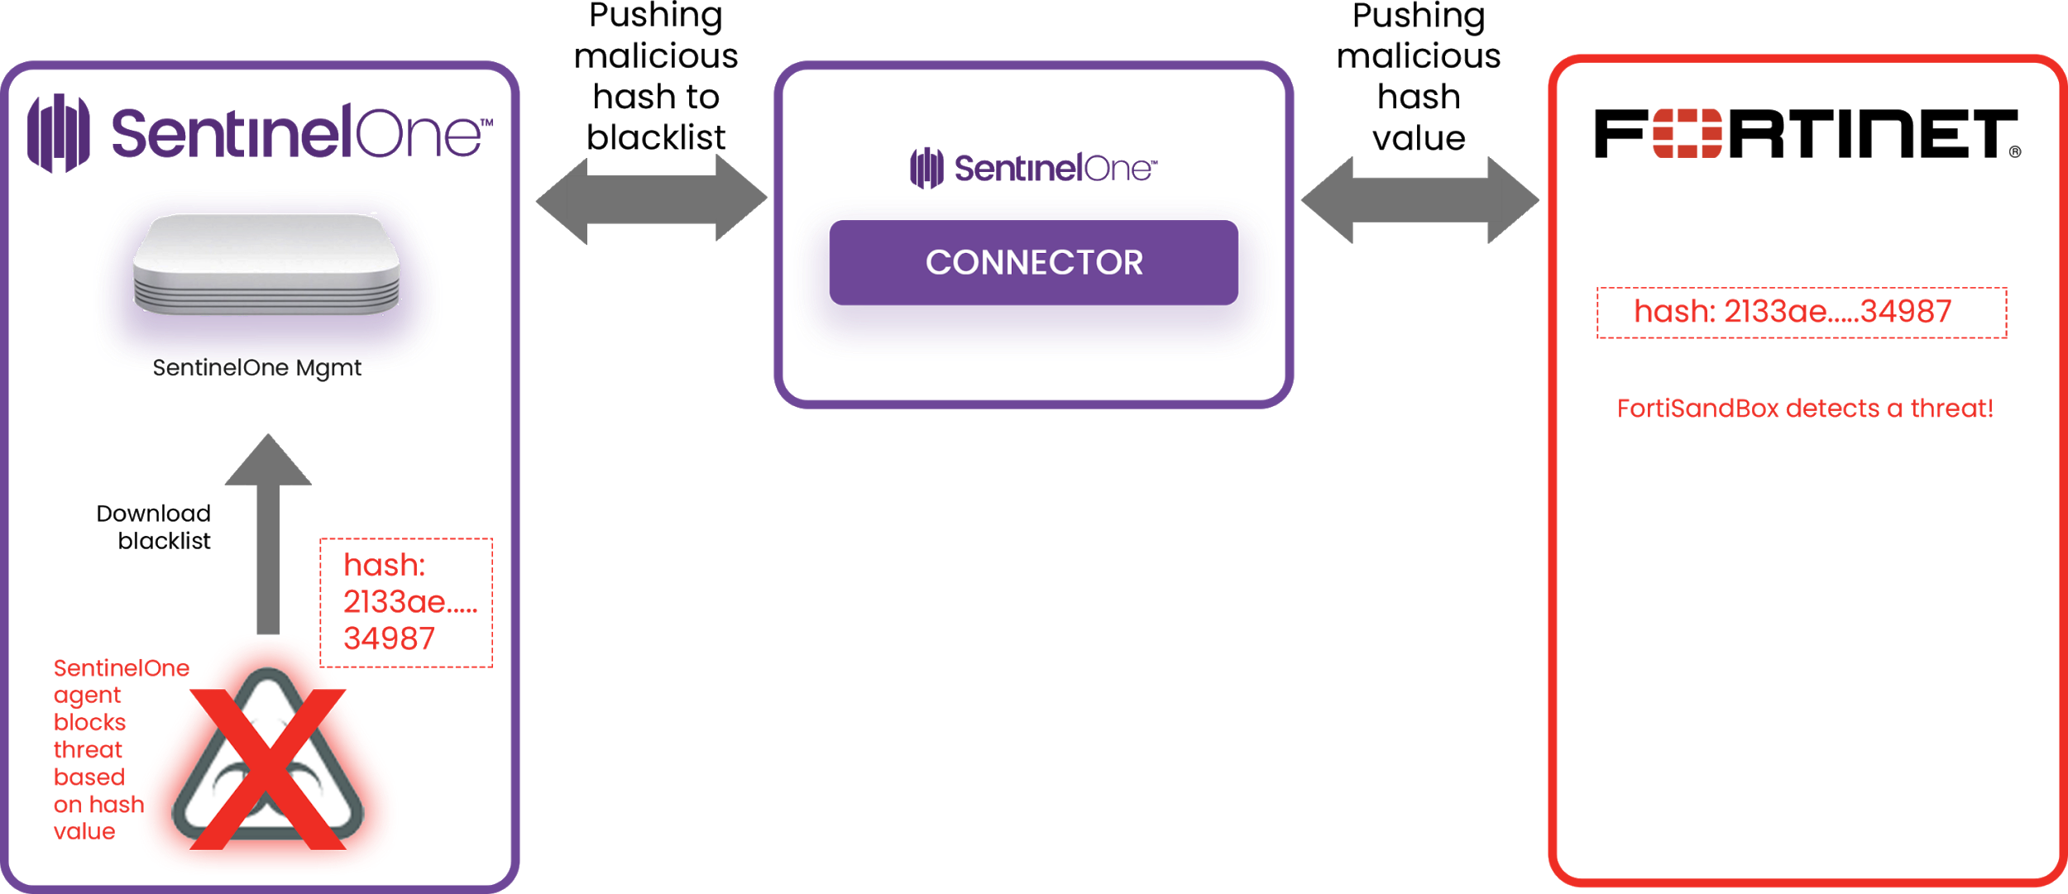
© 2018 SentinelOne All Rights Reserved. Confidential

Slide 9
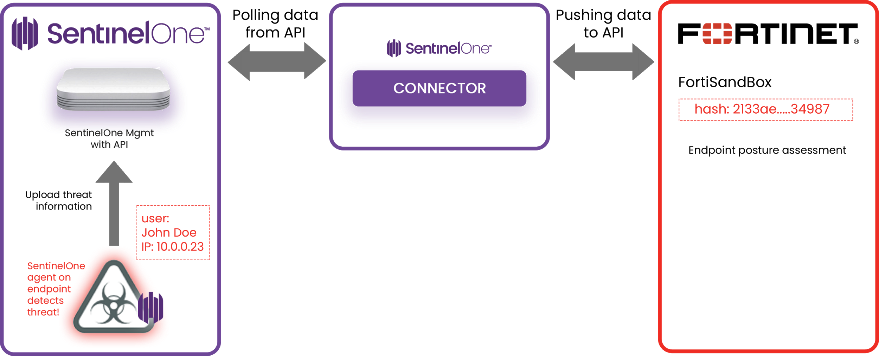
© 2018 SentinelOne All Rights Reserved. Confidential

Slide 10
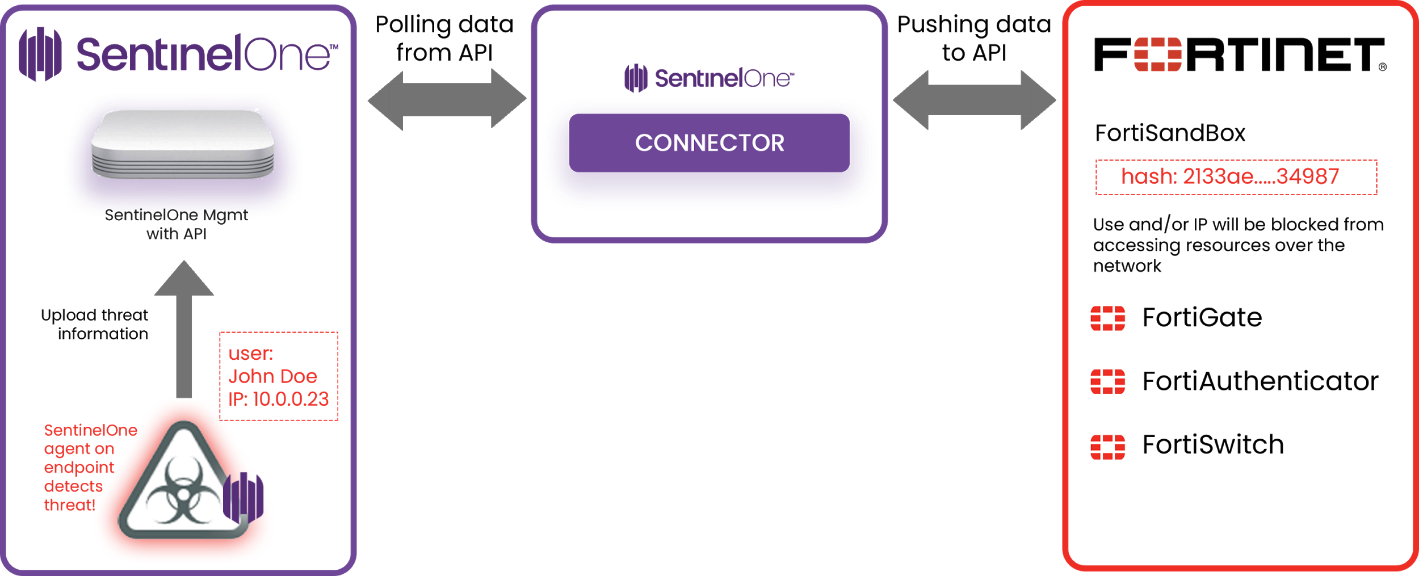
© 2018 SentinelOne All Rights Reserved. Confidential

Slide 11
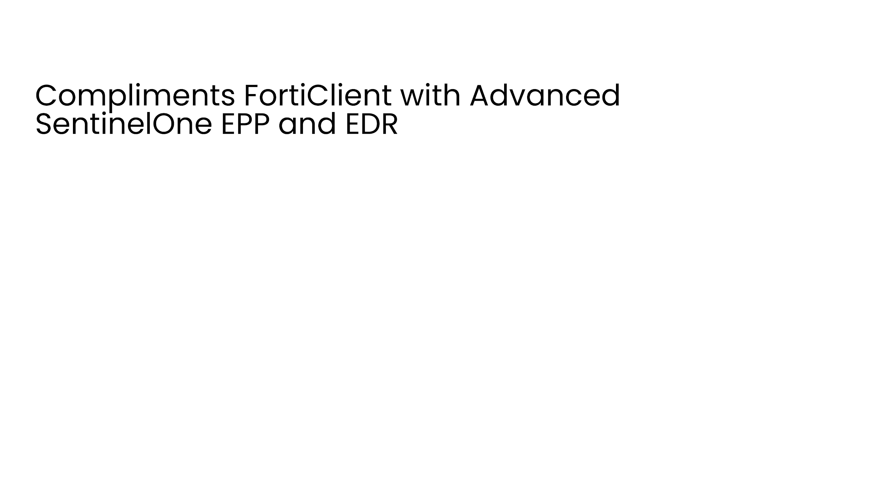

SentinelOne
Advanced EPP (endpoint protection platform) and EDR (endpoint detection and response) in one platform and one agent that protects, detects, and responds to across all attack vectors
- Protect: Static AI (file based) protection - Machine learning analysis on file based vector
- Detect: AI based behavioural detection - Machine learning on zero day malware (file less-malware attacks) eg, memory, powershell, exploit attack vectors
- Respond: Rapidly eliminate threats with zero touch mitigation, full response and remediation saving time:
                - Automatically rollback attacks to last known working state
                - Provide threat hunting and detailed forensic analysis on malware attacks including encrypted data (Deep Visiblity)
FortiClient
Signature based AntiVirus
Signature based AntiExploit
Web Filtering
Application Firewall
SSL and ISPEC VPN
© 2018 SentinelOne All Rights Reserved. Confidential

Slide 12
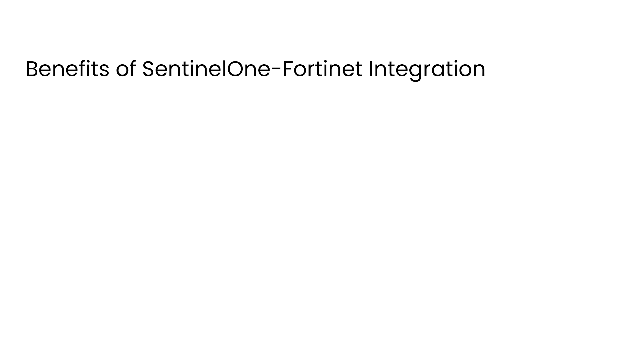
Provides superior Network / Endpoint Security solution with combined Fortinet + SentinelOne solution v PAN + TRAPS for end users and new opportunities for common partners
Helps blocks PAN (TRAPS) out from any incumbent Fortinet Accounts with advanced SentinelOne
EPP and EDR capabilities:
SentinelOne Competitive advantage v TRAPS:
  Artificial Intelligence multi-layer protection for all classes of threats (file based, file-less, scripts..)
  Full remediation and Rollback- EDR capabilities (Threat hunting, Forensic analysis)
  Full Visibility into encrypted traffic across network
  Full platform support for all attack vectors – Windows, Mac, Linux
Mutli-Tenant support- On premise and / or Cloud solution
Reduced time to value with validated solution architecture through Fortinet + SentinelOne partnership
© 2018 SentinelOne All Rights Reserved. Confidential

Slide 13

API skillset
Enterprise customers
Network security background - integrating sandbox technology and cyber security solutions
Competing regularly with PAN (TRAPS)
Ability to support their API integration (access to community support from SentinelOne)
Looking for new opportunities to disrupt incumbent legacy AV vendors in adjacent market to Network security
© 2018 SentinelOne All Rights Reserved. Confidential

Slide 14
Already available: FortiSIEM
Early April: FortiMail via FortiSandBox (threat intelligence)
End of April: FortiGate (network quarantine)
May: FortiAuthenticator (user isolation)
More to come…
© 2018 SentinelOne All Rights Reserved. Confidential

Slide 15

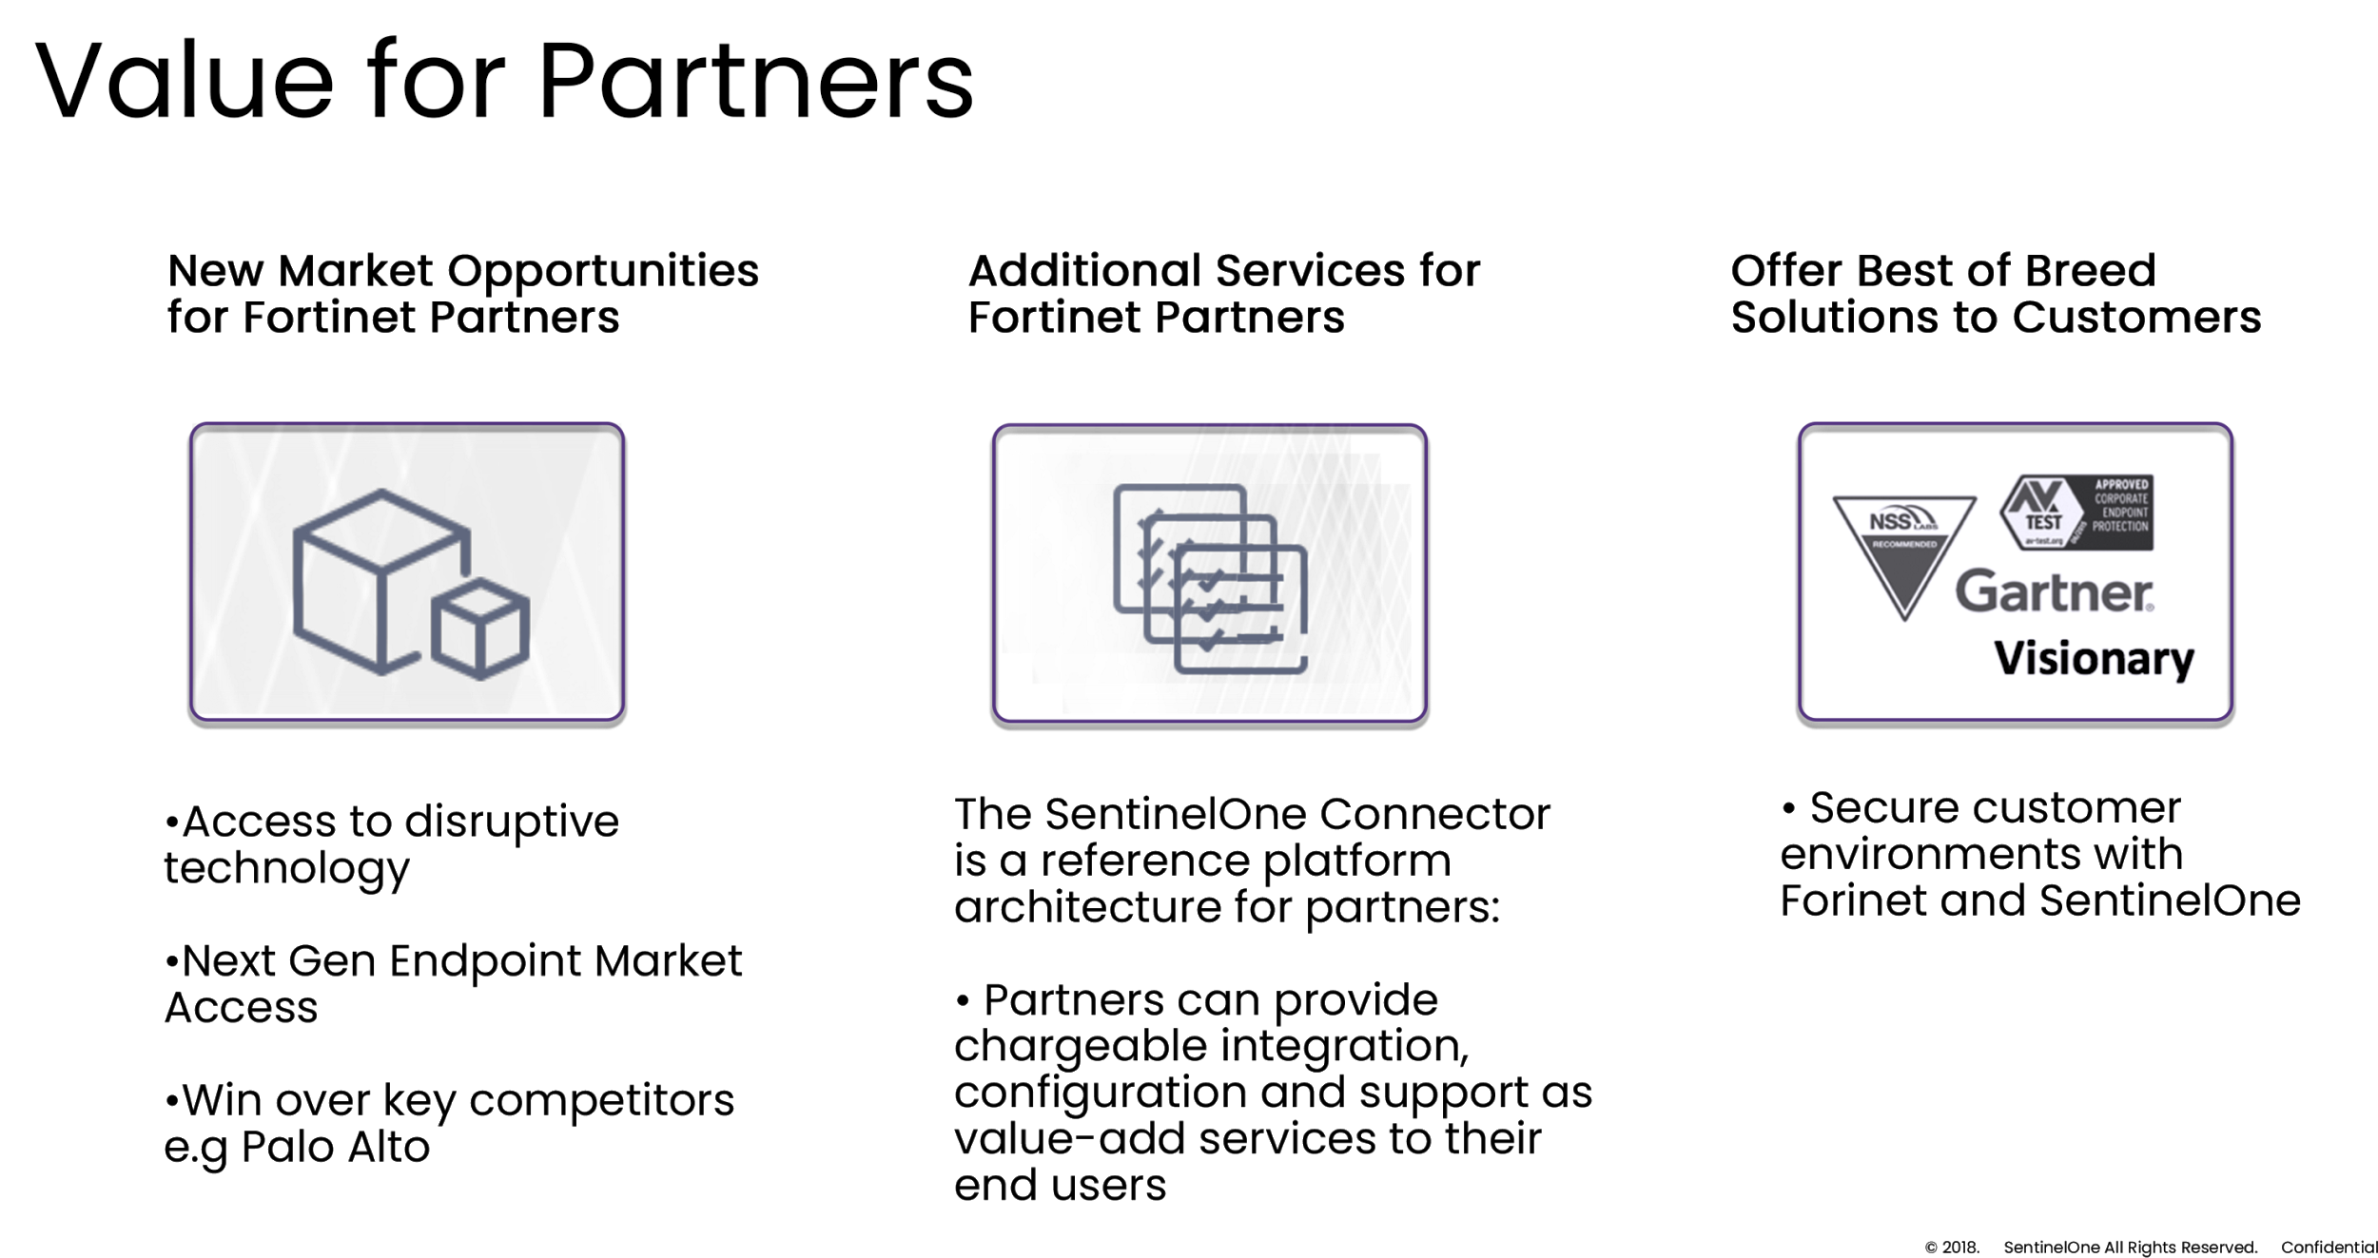
© 2018 SentinelOne All Rights Reserved. Confidential

Slide 16

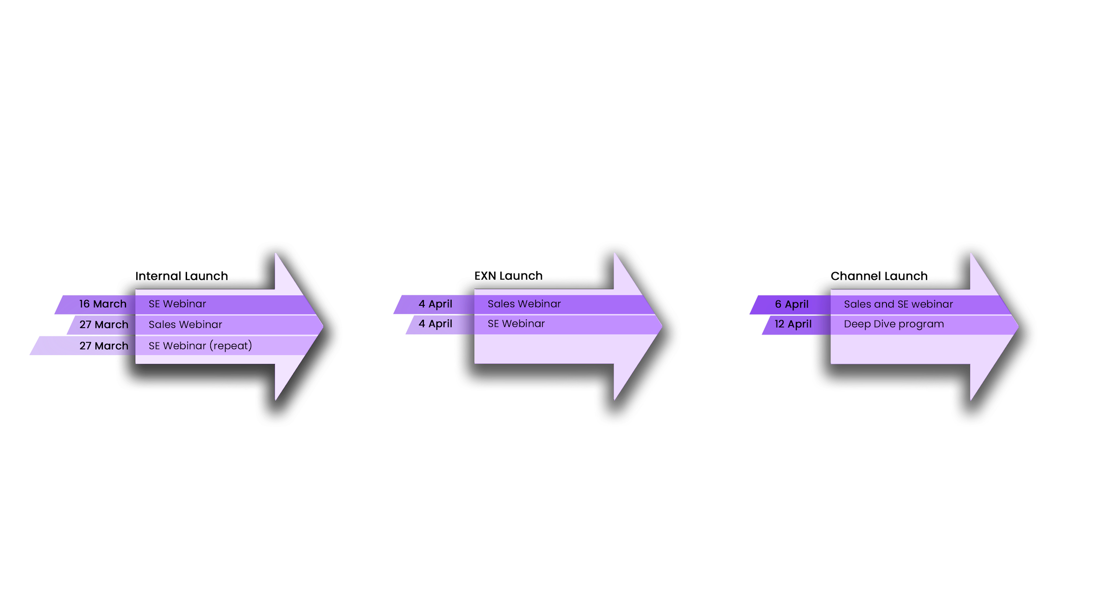
© 2018 SentinelOne All Rights Reserved. Confidential

Slide 17

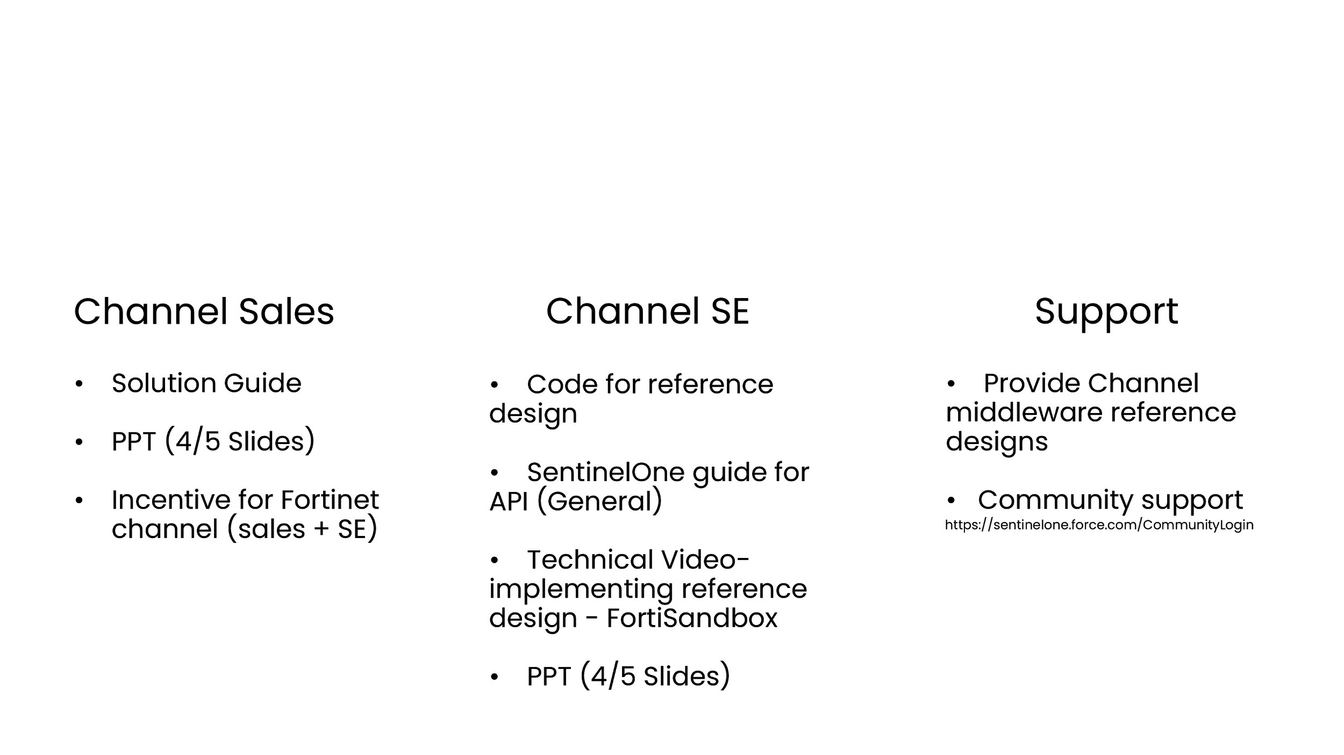
© 2018 SentinelOne All Rights Reserved. Confidential

Slide 18
SentinelOne thank you for your time

