Slide 1
Fortinet makes MSSP Easy!
How to Diversify your Go To Market
and Increase Revenues and Profitability
[Johanna Caperman] – [Channel Account Manager]
Notes:
Welcome to this Session, my name is Johanna Caperman and I work at Exclusive Networks as one of our Channel Account Managers here in Sweden.
Todays session will show you how easy it is to develop your MSSP services with Fortinet, to quickly increase your revenues and profitability.
[ click ]

Slide 2




Agenda
1
Why move to MSSP?
2
Getting started with Fortinet is easy
3
A Fortinet MSSP journey
4
Call to Action
Notes:
Today we we'll be covering:
We'll explore the driving forces behind the increasing demand for managed security services and the challenges that businesses face in securing their networks.
Moving on, we'll dive into the management platforms Fortinet provides to get you started very easily and quickly on your MSSP journey.
Next, we'll embark on the MSSP journey together.
We will outline the different stages of this journey, with particular attention to the Advocate and Select MSSP levels.
Lastly, as we wrap up this session, we'll provide you with a wealth of supporting resources.
And we will conclude on the importance of taking action and putting the knowledge gained today into practice.
[ click ]

Slide 3
Why move to MSSP?
Market Drivers & Opportunities
Notes:
So, without further ado, let's dive into our first topic: the driving forces behind the demand for managed security services.
With the constant increase of cyber threats and compliance requirements, organizations are feeling the pressure to hire and keep specialized security expertise and deploy proactive measures to protect their data and infrastructure.
However, there is a shortage of skilled cybersecurity professionals, leading to a reliance on managed security service providers (MSSPs).
This all results in a significant growth in security spend, particularly on remote monitoring and management services for SMBs.
[ click ]

Slide 4



Grow your Revenues x2 with MSSP Services
It is estimated that Managed Security Services are growing twice as fast as Network Security products for SMB’s
x2
14%
Advocate / Select Partners
with MSSP Business Model
generate 2 x more Revenues
than Integrators only
CAGR
2020-2025
MANAGED Security Services
6%
29.8 Bn$
CAGR
2020-2025
Firewall Management, Remote Monitoring …
(Worldwide spend in 2025)
NETWORK SECURITY PRODUCTS
22.1 Bn$
Firewall, UTM …
(Worldwide spend in 2025)
Source: Analysys Mason – Worldwide SMB Security Spending, 2020-2025
Notes:
By seizing this opportunity, you have the potential to grow your revenues very significantly:
Let’s look at numbers.
[ click ]
- Data from Analysts and from our own Channel Partners community indicate that, by simply adding MSSP services to your portfolio,
you could double the revenues you are already making by reselling network security products.
- For SMB customers alone, the market for Managed Security Services is significantly bigger than the market for Network Security Products.
- Moreover, this market is growing twice faster.
[ click ]
And we observe the same trend with our Advocate and Select Partners community:
-Those with a MSSP Business Model generate, on average, about twice the revenues of those with only an Integrator Business Model.
[ click ]

Slide 5
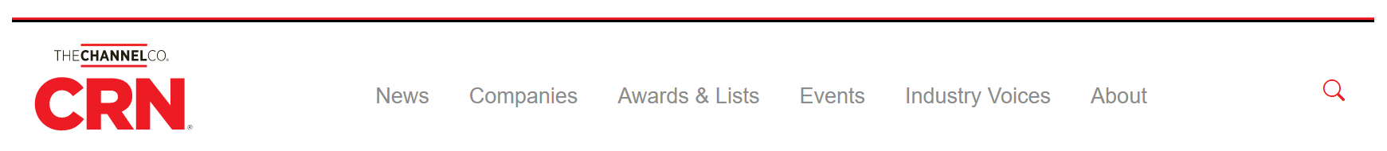
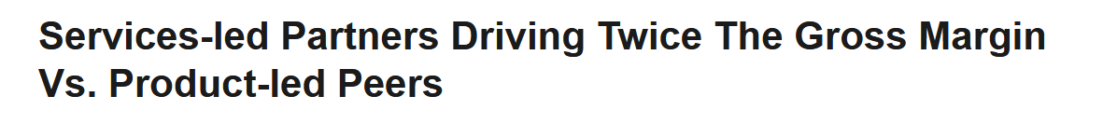

Improve your Margins with MSSP Services
Adopting MSSP business model have the potential to double gross margins
x2
Margins
Source: https://www.crn.com/slide-shows/running-your-business/services-led-partners-driving-twice-the-gross-margin-vs-product-led-peers
Notes:
The second business driver is Margins:
- Managed Security Services generate much higher margins than just reselling Network Security Products.
Channel Reseller News reported that Service-led Partners generate, on average, Margins twice higher than their Product-led peers.
This is because Reseller business is highly competitive, which drives down margins, while Services allow for more differentiation.
[ click ]
And not only that: as an MSSP, you are entering a different relationship with your customers, moving to a recurring revenue model for the services you deliver.
This can be charged monthly, quarterly, yearly: either way, your finance team will thank you for this predictability, which will ultimately translate into more profitability.
[ click ]

Slide 6



Partner Benefits from building Managed
Security Services:
Increase profits
Growing your business through recurring revenue
Competitive advantage
Customer loyalty
Notes:
We have already seen two of the main Business Drivers to move to MSSP: profitability and growth, through recurring revenues.
But there are more benefits.
[ click ]
MSSP services also allow you to differentiate:
- The products you sell are the same as the products your competitors resell too.
- As an MSSP you have many Services and Services Level Agreements (SLAs) you can implement and deliver, and the service and value you can add at the top is linked with your DNA as partners.
This gives you a real competitive advantage.
[ click ]
Last but not least, MSSP Services help you win Customer Loyalty:
- If the services you deliver are aligned with your customers’ expectations, why should they look at other service providers?
Managed Security Services will drastically change the relationship you have with your Customers, for the better.
[ click ]

Slide 7



MSSP: Doing-it-Yourself is Not Easy
Managing Firewalls individually - without adequate MSSP management tools - is difficult
Lack of Scalability
& Flexibility
Time
& Resources
Operational Complexity
Costs
Notes:
Providing such services without proper Management tools is possible, but it is not easy.
Operational complexity arises as each firewall requires separate configuration, deployment, monitoring, and maintenance.
This complexity leads to inefficiencies, potential errors, and difficulties in maintaining a standardized security posture across multiple devices.
[ click ]
Scalability becomes challenging as policy and firmware consistency must be ensured across numerous firewalls, along with asset management and licensing complexities.
[ click ]
Time and resource management suffer as handling individual firewalls demands significant resource allocation and impacts overall efficiency.
[ click ]
Additionally, Cost management becomes a concern due to increased administration and staffing costs.
This is why streamlining and centralizing firewall management is crucial to overcome these challenges and deliver effective managed firewall services.
---------- ADDITIONAL NOTES TO THE PRESENTER --------------------------------------------
This slide elaborates on the challenges faced by MSPs when delivering a managed firewall service while managing firewalls individually
Operational Complexity:
When managing firewalls individually, MSPs face increased operational complexity. Each firewall requires separate configurations, deployments, and ongoing monitoring and maintenance efforts. This can lead to inconsistencies, errors, and difficulties in maintaining a standardized security posture across multiple devices. It becomes challenging to streamline processes and ensure efficient management of all firewalls simultaneously.
Scalability & Flexibility:
Managing individual firewalls poses scalability and flexibility challenges for MSPs. Ensuring policy and firmware consistency across numerous devices becomes a complex task, often resulting in inconsistencies and potential security vulnerabilities. Additionally, managing assets and licenses for each firewall separately can become cumbersome, hindering the ability to efficiently scale security services. Reporting and analytics may also suffer due to fragmented data across many devices.
Time & Resource Management:
Managing firewalls individually requires significant resource allocation, impacting time efficiency and resource management for MSPs. Handling numerous firewalls separately demands additional time and effort to configure, deploy, and maintain each device. This can strain the available resources, limiting the ability to effectively manage and support a growing customer base. Time spent on repetitive tasks for individual firewalls could be better utilized for strategic activities and customer-focused services.
Cost Management:
Managing firewalls individually comes with cost implications for MSPs. Administration costs increase as each firewall requires separate management interfaces and tools. Staffing costs can rise due to the need for specialized expertise for each firewall platform. The cumulative expenses associated with managing individual firewalls can impact profitability and hinder cost-effectiveness.

Slide 8
Fortinet makes MSSP Easy!
Setup your MSSP services quickly with Fortinet
Notes:
Let’s see now how Fortinet can help you overcome these difficulties with centralized management tools that make MSSP easy!
[ click ]

Slide 9










Fortinet makes MSSP Easy!
Introducing Options and Steps forward: from the easiest to the most profitable
A
Test the MSSP Market
Resell Fortinet Managed FortiGate Service
OPTION
Integrator
Delegate to Fortinet
Develop Managed Services as you Sell
Use FortiGate Cloud Management Platform
You sold multiple Managed FortiGates
Increase scalability with FortiCloud
B
Develop additional Services
OPTION
Unlock Services &
Free Trials with FortiCloud Premium
Manage Services Yourself
Notes:
Let me first introduce the different options and steps we are going to describe.
I will go from the simplest to the most profitable.
The first option is relevant if you who would like to test and better understand the market potential with their Customers … before setting up your own Managed Services.
In this case, you can simply start reselling Fortinet Managed FortiGate Services to understand the market, pricing structure and demand for these services before setting your own.
Once you are ready, or if you are already decided, you can move to option B, which is about Managing Services Yourself.
[ click ]
To help you doing this, Fortinet will provide several tools, which we will describe each in turn:
The first tool will help you manage FortiGate devices and their downstream environment
The second will help you scale up, as you manage more and more customers
The last one will help you develop business with advanced services
All these Management tools are provided “As-a-Service” which means that they are immediately actionable, without requiring you to deploy any management infrastructure.
[ click ]

Slide 10
Fortinet makes MSSP Easy!
Introducing Options and Steps forward: from the easiest to the most profitable
A
Test the MSSP Market
Your best option
to quickly test the MSSP market
Resell Fortinet Managed FortiGate Service
OPTION
Integrator
Delegate to Fortinet
Develop Managed Services as you Sell
Using FortiGate Cloud Management Platform
You sold multiple Managed FortiGates
Increase scalability with FortiCloud
B
Develop additional Services
OPTION
Unlock Services &
Free Trials with FortiCloud Premium
Manage Services Yourself
Notes:
But let’s start with the first Option, which is about testing the MSSP Market ... if you are not ready or decided to setup your own services yet.
In this case, you can take advantage of Fortinet Managed FortiGate Service.
[ click ]

Slide 11

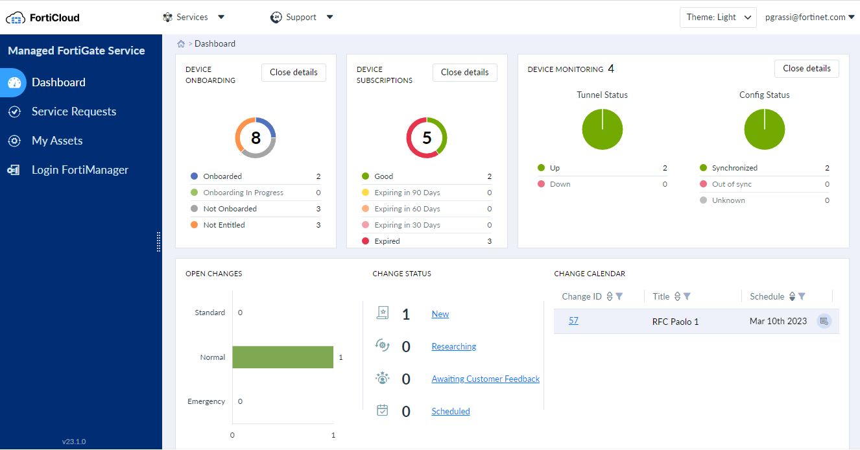
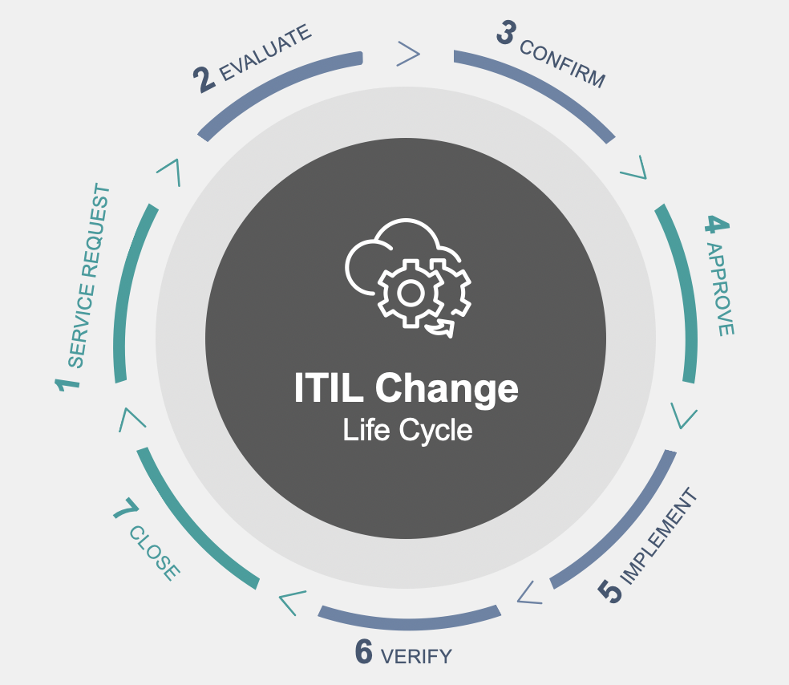
MFGS: Fortinet Managed FortiGate Services
No Upfront Investment, Immediately Actionable: your best option to quickly test the MSSP market
MFGS
Managed FortiGate Service
1 x SKU to add on top of any FortiGate device
Sell Through
Partner simply resells Fortinet Managed
FortiGate Service to their Customers
Customer
Fortinet
or
Managed Through Partner
Partner is the interface of Fortinet Managed FortiGate Service to their Customers
Partner
Fortinet
Notes:
This is a Managed Security Service entirely managed by Fortinet … immediately actionable … with no upfront investment required on your side:
- You just need to resell a simple SKU, added on top of any FortiGate device.
This Cloud-based managed service ranges all the way from Next-Gen Firewall provisioning and hardening, security policy learning and optimization, to complex secure SD-WAN set-ups and configuration changes.
Fortinet security experts will manage FortiGates on a 24x7 schedule, updating configurations on your Customer’s behalf, according to Fortinet Best Practices, from Network Operations Centers located in Germany, USA, Canada and Japan.
[ click ]
You may decide to simply resell this service and not get involved in its delivery at all: in this case, your Customer will dialog directly with Fortinet Managed Service Team and dialog with them for each of their request.
The service is available in English and runs on a 24x7 schedule.
- This will allow you to test demand for MSSP services, as well as understand the structure for this type of services and get a useful price reference point.
[ click ]
You may as well decide to be the interface between your Customers and Fortinet Managed Service Team.
- This will allow you to deliver managed services to your Customers in their own language, capture more of the margins, and gain in-depth experience with this type of service, preparing a smooth transition to your own future managed Network Security Services.
Either way, this is your easiest option to test the MSSP market.
[ click ]

Slide 12
Fortinet makes MSSP Easy!
Introducing Options and Steps forward: from the easiest to the most profitable
A
Test the MSSP Market
Your best option
to quickly test the MSSP market
Resell Fortinet Managed FortiGate Service
OPTION
+ No Upfront Investment
+ Immediately Actionable
Integrator
Delegate to Fortinet
Develop Managed Services as you Sell
Using FortiGate Cloud Management Platform
You sold multiple Managed FortiGates
Increase scalability with FortiCloud
B
Develop additional Services
OPTION
Unlock Services &
Free Trials with FortiCloud Premium
Manage Services Yourself
Notes:
Again, there is no upfront investment needed … and this service is immediately actionable.
If you don’t feel ready yet to provide your own MSSP services, this is an option to consider.
[ click ]

Slide 13
Fortinet makes MSSP Easy!
Introducing Options and Steps forward: from the easiest to the most profitable
A
Test the MSSP Market
Your best option
to quickly test the MSSP market
Resell Fortinet Managed FortiGate Service
OPTION
+ No Upfront Investment
+ Immediately Actionable
Integrator
Delegate to Fortinet
Develop Managed Services as you Sell
Your MSSP Platform to manage FortiGate devices
Using FortiGate Cloud Management Platform
You sold multiple Managed FortiGates
Increase scalability with FortiCloud
B
Develop additional Services
OPTION
Unlock Services &
Free Trials with FortiCloud Premium
Manage Services Yourself
Notes:
The most profitable path to the MSSP market, however, is to manage Network Security Services yourself, and for this we provide easy-to-use Cloud-based SaaS Management Platforms.
Let me first introduce FortiGate Cloud, the best ally for Managed Security Service Providers (MSSPs) in their mission to deliver effective & profitable managed firewall services.
[ click ]

Slide 14






Easy Management (SaaS) of FortiGates for MSSPs
Introducing FortiGate Cloud, highly scalable Management platform for MSSPs
FortiGate Cloud
FortiGate
Management
for MSSPs
FortiGate Cloud
FortiGate Cloud
FortiGate Cloud
FortiGate
FortiGuard
FortiGate
FortiGuard
FortiGate
FortiGuard
Customer
Networks
FortiSwitch
FortiAP
FortiSwitch
FortiExtender
Customer 1
Customer 2
…
Customer n
Notes:
Let’s start with a typical Customer base situation.
Some Customers use FortiGate devices primarily for their NextGen firewalling capabilities, most of the time with the added benefits of FortiGuard security services.
Many also take advantage of the convergence with networking to activate SD-WAN capabilities and deploy various combinations of networking devices downstream, such as FortiSwitches, FortiAPs and FortiExtenders.
As an MSSP, the best tool to manage them all is FortiGate Cloud.
[ click ]
This is a Cloud-based Software-as-a-Service platform, so you don’t need to deploy anything.
It is also very scalable: FortiGate Cloud can grow with your requirements from a single FortiGate to a complete managed security services management solution, for thousands of devices across multiple customers.
This allows you to efficiently scale your operations as your customer base expands.
Let’s explore the services delivered by FortiGate Cloud in more details.
[ click ]

Slide 15
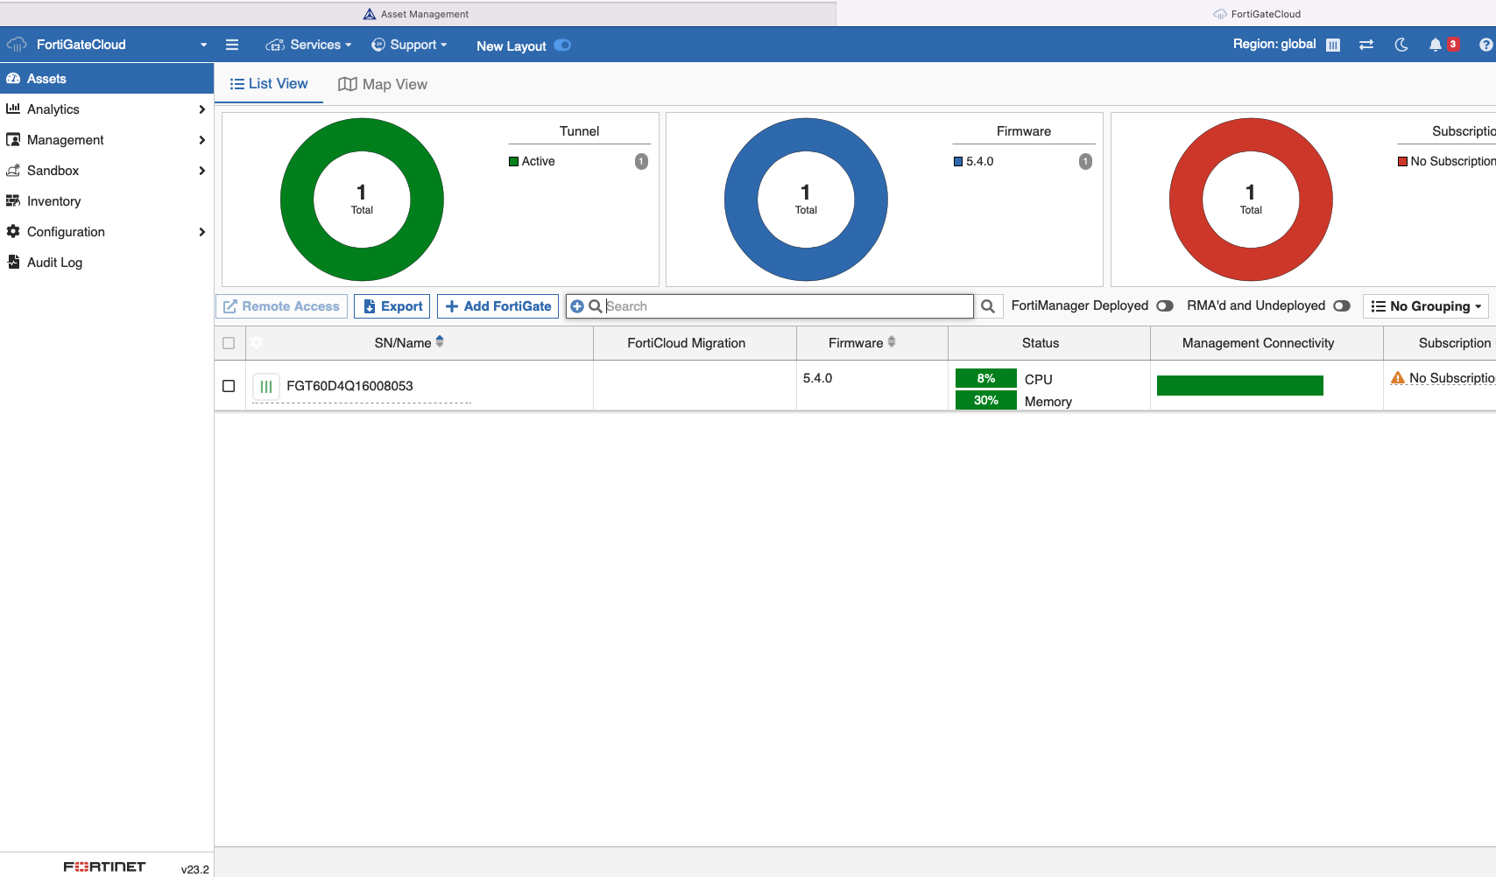
Easy Management (SaaS) of FortiGates for MSSPs
Manage Zero-Touch Deployment + Configuration + Reporting + Analytics + Backups
FortiGate Cloud
FortiGate Cloud
Zero-touch deployment
Configuration management
Reporting & Analytics
Cloud Backups
Log storage in the Cloud (12 months)
FortiGate Cloud
FortiGate
FortiGuard
Manages:
  FortiGate firewalls
    Appliances & VM
  As well as downstream:
    FortiGuard services
    FortiSwitches
    FortiAPs
    FortiExtenders
FortiSwitch
FortiAP
FortiExtender
Notes:
With FortiGate Cloud, MSSPs can easily configure, secure, monitor and troubleshoot their customers’ secure networking devices from a single, intuitive dashboard.
With a user-friendly dashboard, managing the network becomes a breeze, allowing them to focus on delivering exceptional managed security services to their customers.
Let’s now look at its management capabilities.
[ click ]
First of all, FortiGate Cloud simplifies the initial deployment with zero-touch provisioning.
Then, FortiGate Cloud provides a management console to centrally configure individual devices or push configuration to multiple devices, with powerful capabilities to automate and scale:
- You can use scripts to perform repetitive tasks, such as device configuration updates, saving time and effort.
- You can also plan and automate firmware upgrades across multiple devices simultaneously
To aid in reporting, detailed preconfigured and custom reports can be run on demand or scheduled for certain times and distributed by email.
These will help you demonstrate the effectiveness of your security services.
FortiGate Cloud offers secure Cloud backups for device configurations, ensuring quick recovery in case of device failures or configuration issues.
Finally, FortiGate Cloud includes a generous 12 Months Unlimited Log Storage capability, allowing MSSPs to retain and analyse firewall logs for an extended period. This is crucial for compliance, threat detection, and forensic analysis.
Remember that many entry-level FortiGate appliances have no or very limited storage capabilities: in such cases, this capability is a tremendous benefit for Customers.
[ click ]
All these management benefits are available not only for FortiGate devices, appliances or virtual machines, but also to all the FortiGuard services deployed on these devices, and all the networking devices attached downstream: FortiSwitches, FortiAPs, and FortiExtenders.
This expanded capability allows MSSPs to deliver end-to-end network security, providing a seamless and unified experience for both MSSPs and their clients.
[ click ]
---------- ADDITIONAL NOTES TO THE PRESENTER --------------------------------------------
Script functionality to enable automation and customization of management tasks:
You can create and deploy scripts to perform repetitive tasks, such as device configuration updates or firmware upgrades, saving time and effort.
Automating routine operations helps you focus more on strategic security initiatives and customer engagement.
Scheduled upgrade feature:
Keeping your customers' FortiGate devices up to date is essential for optimal performance and security.
With the scheduled upgrade feature, you can plan and automate firmware upgrades across multiple devices simultaneously.
This ensures that your customers' firewalls are always running the latest software versions, benefiting from new features, bug fixes, and security patches.
The FortiGate Cloud dashboard provides visibility and control of the health of the entire network.
It provides detailed information on the applications being used and by whom, bandwidth consumption by AP, client, or application, and much more.
FortiGate Cloud analytics include granular drill-down and filtering functionality to instantly determine how applications, websites, users, and threats are impacting your network.
To aid in reporting, detailed preconfigured and custom reports can be run on demand or scheduled for certain times and distributed by email to interested parties.
You have access to a comprehensive report library, with detailed reports on various metrics, including traffic patterns, threat activities, and device health.
These help you present your customers with professional reports that demonstrate the effectiveness of your security services and provide actionable recommendations for improvement.
FortiGate Cloud offers secure Cloud backups for device configurations.
You can conveniently store and restore configurations, ensuring quick recovery in case of device failures or configuration issues.
Imagine the peace of mind knowing that you have reliable backups readily available to minimize downtime and accelerate recovery processes.
The subscription includes a generous 12 Months Unlimited Log Storage capability, allowing MSSPs to retain and analyse firewall logs for an extended period.
This is crucial for compliance, threat detection, and forensic analysis.
Imagine having access to historical logs for a full year, enabling you to investigate security incidents and identify patterns or trends to enhance your customers' protection.
The central management of downstream FortiSwitches ensures consistent network access control, enhances threat detection capabilities, and simplifies network management tasks.
FortiAP management through FortiGate Cloud provides MSSPs with unified control over wireless access points, enabling them to efficiently configure, monitor, and secure wireless networks.
This integration allows for centralized management of wireless security policies, seamless roaming capabilities, and simplified troubleshooting, delivering a comprehensive and secure wireless experience for clients.
Furthermore, FortiExtender integration expands the management capabilities to cellular network devices.
MSSPs can leverage FortiGate Cloud to oversee and control FortiExtenders, which provide secure connectivity for remote or mobile environments.
This integration enables efficient management and monitoring of cellular connections, ensuring reliable and secure network access for clients in various deployment scenarios.

Slide 16
FortiGate Cloud: Simple & Scalable Licensing
Easy: Minimal upfront investment
Scalable: Pay as you grow device-based license model
FortiGate Cloud
Per MSSP Partner:
1 x FortiGate Cloud Multi-Tenant License
< US$ 1,500
(recommended price)
FCLE-10-FCLD0-161-02-12
Allows you to:
Create dedicate environments (Sub-Accounts) per customer
Define roles and permissions across their own administrators
Per FortiGate device (Appliance or VM):
FortiGate Cloud Management, 1 Year Log Retention
FortiGate Cloud #1
FortiGate Cloud #2
FortiGate Cloud #n
FC-10-00XXX-131-02-DD
Recommended price typically < 10-15% of hardware/UTP bundle
(…)
FortiGate #1
FortiGate #2
FortiGate #n
Notes:
So, what you probably want to know now is, what is the cost to get started?
[ click ]
FortiGate Cloud operates on a pay-as-you-grow model, enabling MSSPs to start with small installations with a cost-effective solution,
and easily expand to larger deployments as their customer base grows.
The cost for a 1-year subscription is typically between 10-15% of the hardware or UTP (Unified Threat Protection) bundle price.
This scalability ensures that MSSPs can meet the evolving needs of their clients without significant upfront infrastructure costs.
And Remember that with FortiGate Cloud, Customers also gain 12 months of unlimited log storage for each FortiGate device.
[ click ]
In addition, FortiGate Cloud offers multitenancy capabilities, with complete tenant isolation, allowing MSPs to confidently manage multiple tenants while maintaining data privacy and security.
This Multi-Tenant license, has an annual suggested retail price (RRP) below $1,500, which offers amazing value as it unlocks unlimited sub-accounts.
To put it into perspective, we have seen single accounts successfully managing over 25,000 devices through many sub-accounts.
By leveraging the FortiGate Cloud Multi-Tenant License, MSSPs can really unlock the full potential of FortiGate Cloud.
[ click ]

Slide 17
Fortinet makes MSSP Easy!
Introducing Options and Steps forward: from the easiest to the most profitable
A
Test the MSSP Market
Your best option
to quickly test the MSSP market
Resell Fortinet Managed FortiGate Service
OPTION
+ No Upfront Investment
+ Immediately Actionable
Integrator
Delegate to Fortinet
Develop Managed Services as you Sell
Your MSSP Platform to manage FortiGate devices
Using FortiGate Cloud Management Platform
+ Minimal upfront Investment
+ Scalable Costs
You sold multiple Managed FortiGates
Increase scalability with FortiCloud
B
Develop additional Services
OPTION
Unlock Services &
Free Trials with FortiCloud Premium
Manage Services Yourself
Notes:
To summarize, FortiGate Cloud allows you to develop managed security services for all the FortiGate devices of your Customers, along with attached FortiGuard services and downstream networking devices, with a scalable licensing model and very minimal upfront investment.
[ click ]

Slide 18
Easily manage large numbers of customers
Support : How easily can you search for a Support Ticket across all your Customers?
Asset Management: How easily an you search for a Serial Number across all your Customers?
How easily can you search for a License Number across all your Customers?
How easily can you view all the expired or decommissioned units?
Identity Management: How easily can you manage multiple Accounts, each with its Credentials?
How easily can you navigate between these Accounts?
How can you integrate with third-party Identity Management components?
Notes:
As you expand your business and increase the number of managed Customers, you will be looking for any opportunity to save time on repetitive tasks and streamline your operations.
For example, when someone calls support with a Support Ticket number, you’ll want to very quickly find back all information about this Customer.
[ click ]
It is the same story if you need to make a search from a Serial Number or a License Number.
You will also want to be able to search across your whole Customer base for expired or decommissioned units.
[ click ]
With many accounts, each with its own credentials, you will want to streamline your navigation from one account to another with Single-Sign-On.
You will also face more sophisticated request, such as integrating with a third-party vendor used by a Customer for Identity Management.
The question is not only whether you can do these tasks or not, but how easily and fast you can do them.
[ click ]

Slide 19
Fortinet makes MSSP Easy!
Introducing Options and Steps forward: from the easiest to the most profitable
A
Test the MSSP Market
Your best option
to quickly test the MSSP market
Resell Fortinet Managed FortiGate Service
OPTION
+ No Upfront Investment
+ Immediately Actionable
Integrator
Delegate to Fortinet
Develop Managed Services as you Sell
Your MSSP Platform to manage FortiGate devices
Using FortiGate Cloud Management Platform
+ Small upfront Investment
+ Scalable Costs
You sold multiple Managed FortiGates
Your MSSP Management tool for scalability
Increase scalability with FortiCloud
B
Develop additional Services
OPTION
Unlock Services &
Free Trials with FortiCloud Premium
Manage Services Yourself
Notes:
To help you with all these scalability issues related to Support, Asset and Identity Management, we have developed a dedicated management platform: FortiCloud.
[ click ]

Slide 20

Managing large numbers of customers more effectively
Introducing FortiCloud
FortiCloud
Multiple Customer
Management
for MSSPs
FortiCloud
Single Customer
Management
for MSSPs
FortiGate Cloud
FortiGate Cloud
FortiGate Cloud
FortiGate
FortiGuard
FortiGate
FortiGuard
FortiGate
FortiGuard
Customer
Networks
FortiSwitch
FortiAP
FortiSwitch
FortiExtender
Customer 1
Customer 2
…
Customer n
Notes:
FortiCloud is a top-layer MSSP Management platform, that enhances your capacity to manage large numbers of Customers.
As we will see later, it can help you with the management of much more than just FortiGate Cloud.
But let’s have a look at its capabilities.
[ click ]

Slide 21


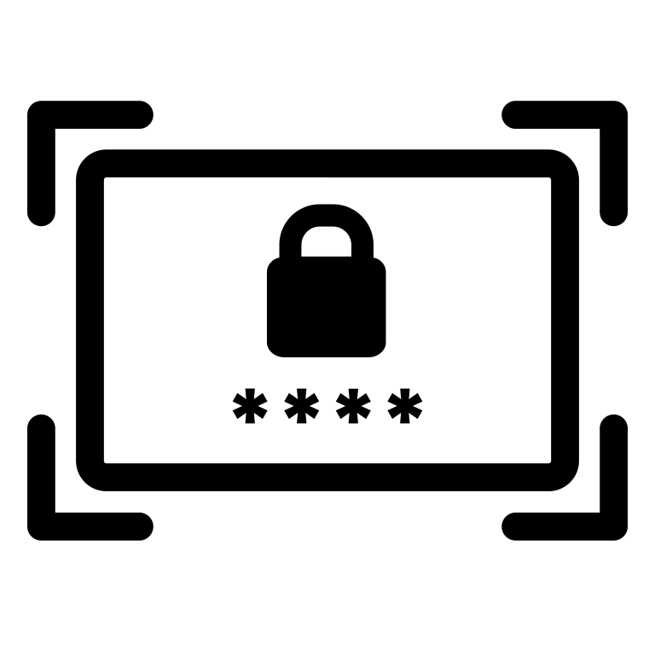
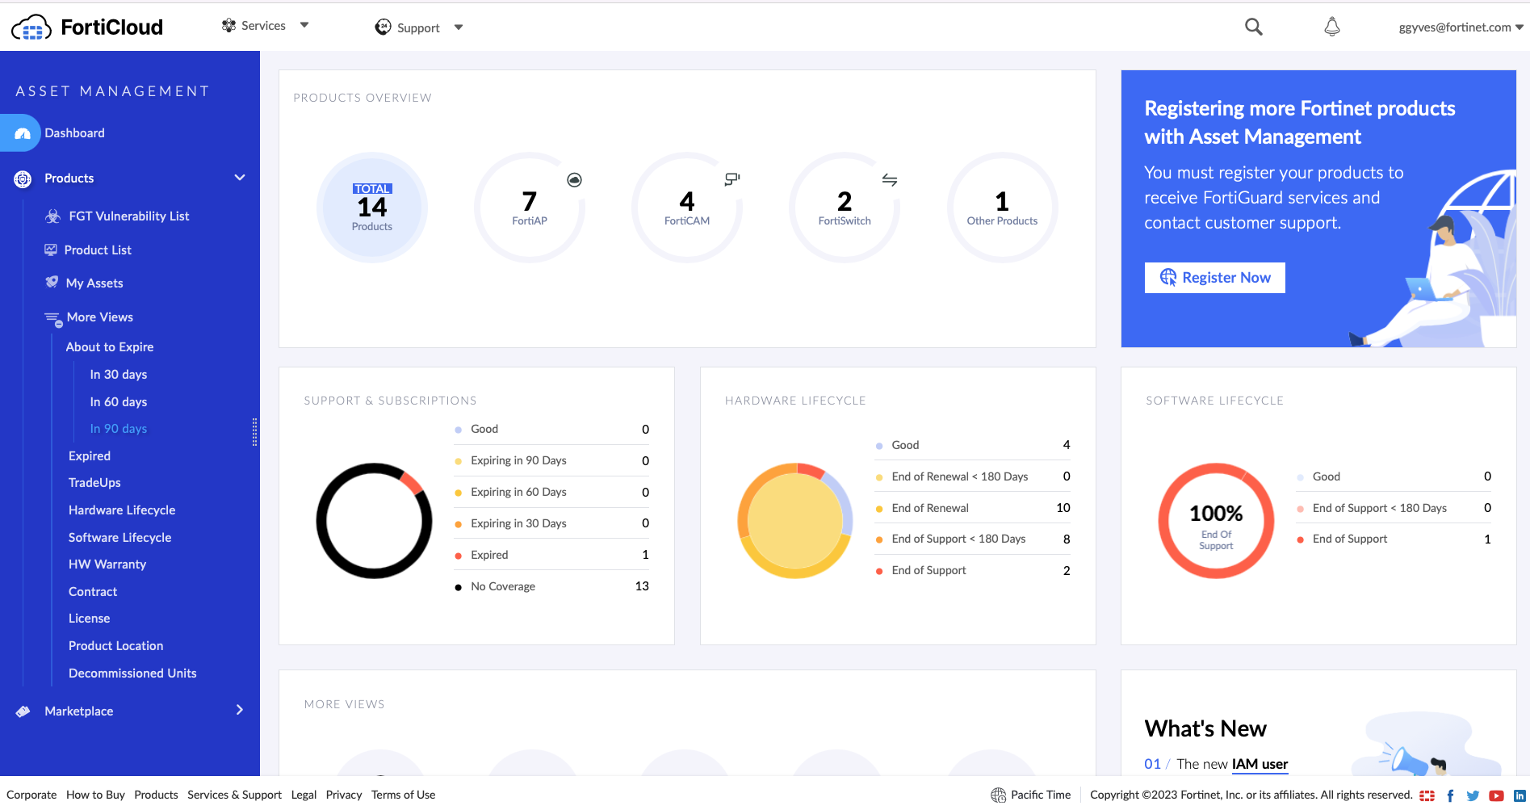
Managing large numbers of customers more effectively
Centrally manage Assets + Identities + Access Permissions + Support Tickets …
FortiCloud
Support Tickets
Management
Asset
Management
Identity & Access Management
FortiCloud
Critical Management Functions
FortiCloud
FortiGate Cloud
FortiGate Cloud
FortiGate Cloud
FortiGate Cloud
Notes:
FortiCloud provides a consolidated view of the complete managed estate through a single FortiCloud account per MSSP.
It simplifies operations by providing a centralized platform for managing Support, Assets, Identities and Access across multiple customer deployments, offering a unified view of all managed Fortinet devices.
It enables rapid deployment and configuration, saving time during onboarding.
MSSPs can deliver a better customer experience with simplified management, proactive monitoring, and quick response capabilities.
Additionally, seamless integration with the broader Fortinet ecosystem empowers MSSPs to enhance their service offerings and provide comprehensive security solutions to their customers.
[ click ]
---------- ADDITIONAL NOTES TO THE PRESENTER --------------------------------------------
Detailed list of Benefits
Simplified Operations:
FortiCloud provides a centralized platform for managing multiple customer deployments from a single interface. This simplifies the management process for small MSSPs by offering a unified view of their customers' Fortinet devices, including firewalls, switches, and access points. It reduces complexity and streamlines management tasks, allowing MSSPs to efficiently oversee their customers' networks.
FortiCloud also enables rapid deployment of Fortinet devices. Small MSSPs can quickly set up and configure customer devices using intuitive user interface available in the platform. This saves time and effort during the initial deployment phase, allowing MSSPs to onboard customers more efficiently.
2. Scalability and Flexibility:
FortiCloud is scalable and flexible, catering to the needs of small MSSPs. Whether managing a small number of customer deployments or scaling up to handle additional customers, FortiCloud can adapt to accommodate growth. MSSPs can start small and expand their services as their customer base increases, without worrying about infrastructure limitations.
3. Enhanced Profitability:
FortiCloud offers cost efficiency advantages for small MSSPs. It eliminates the need for significant upfront investments in hardware or software infrastructure, reducing capital expenses. Additionally, FortiCloud's cloud-based model eliminates the need for ongoing maintenance and hardware upgrades, reducing operational expenses for MSSPs. This reduces the overall cost of delivering a managed service, increasing the likelihood of delivering a profitable service.
4. Improved Customer Experience:
FortiCloud enables small MSSPs to deliver a better customer experience. The platform's simplified management, proactive monitoring, and quick response capabilities allow MSSPs to efficiently address customer needs, provide timely support, and ensure high levels of customer satisfaction.
5. Fabric Integration:
FortiCloud seamlessly integrates with other Fortinet solutions and services, offering additional opportunities for small MSSPs. They can leverage the broader Fortinet ecosystem to enhance their service offerings, expand their security capabilities, and provide comprehensive solutions to their customers.
For example: FortiCloud integrates seamlessly with FortiGate firewalls, providing centralized management and control. MSSPs can efficiently monitor and configure FortiGate devices through the FortiCloud platform, ensuring consistent policies and security across the network.
FortiSandbox: By integrating with FortiSandbox, FortiCloud enables advanced threat detection and analysis. MSSPs can utilize sandboxing capabilities to identify and mitigate sophisticated threats, enhancing their security offerings and protecting customers from evolving cyber threats.

Slide 22
FortiCoud: free Platform for MSSPs
Your free MSSP management platform for scalability
FortiCloud
Per MSSP Partner:
1 x FortiCloud Platform Free
Notes:
The great news about FortiCloud platform is that it is entirely free!
To access your FortiCloud platform, simply visit www.forticloud.com.
If you already have a support portal account, you can seamlessly transition into FortiCloud using your existing login credentials.
[ click ]

Slide 23
Fortinet makes MSSP Easy!
Introducing Options and Steps forward: from the easiest to the most profitable
A
Test the MSSP Market
Your best option
to quickly test the MSSP market
Resell Fortinet Managed FortiGate Service
OPTION
+ No Upfront Investment
+ Immediately Actionable
Integrator
Delegate to Fortinet
Develop Managed Services as you Sell
Your MSSP Platform to manage FortiGate devices
Using FortiGate Cloud Management Platform
+ Small upfront Investment
+ Scalable Costs
You sold multiple Managed FortiGates
Your MSSP Management tool for scalability
Increase scalability with FortiCloud
+ Better Scalability
+ Time Saving
B
Develop additional Services
OPTION
Unlock Services &
Free Trials with FortiCloud Premium
Manage Services Yourself
Notes:
To summarize, FortiCloud improves scalability when you need to manage many FortiGate deployments, saving you time and helping you deliver better customer experience through faster responses and proactive actions.
[ click ]

Slide 24
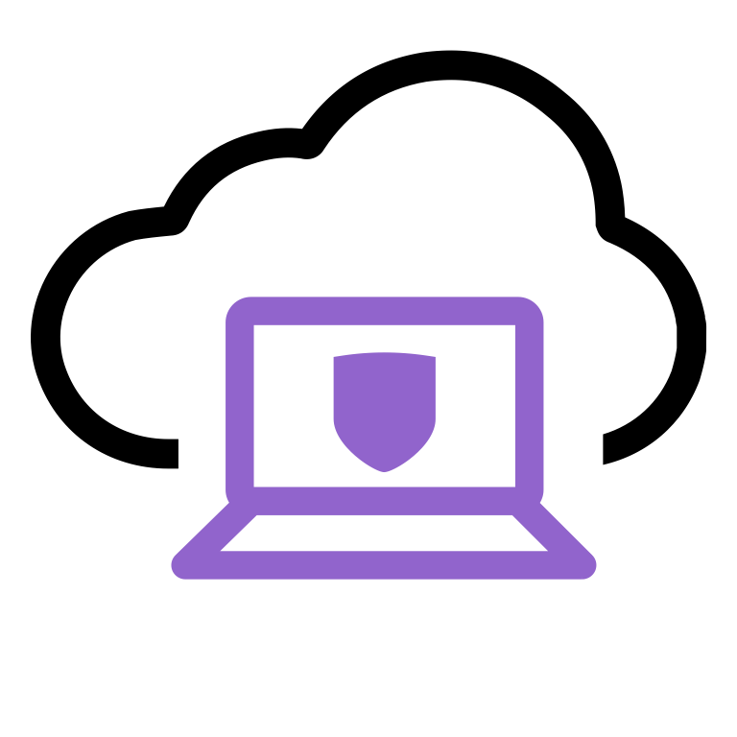
Flexible & Future-Proof infrastructure to expand MSSP services
FortiCloud
FortiGate Cloud
FortiGate Cloud
FortiGate Cloud
FortiClient Cloud
FortiSASE
FortiGate
FortiGate
FortiGate
Etc …
FortiGuard Services
FortiSwitch
FortiAP
FortiExtender
Managed
NextGen Firewall
Managed Unified Threat Protection
Managed
Office Network
Managed
Endpoint Security
Develop Your
Core Offering
Build a solid managed
NextGen Firewall service
Extend to advanced
Network Security Services
Cover advanced IPS, antimalware, web security …
Extend Your Management Boundary
Cover the LAN with integrated Switching, WiFi …
Extend to
Endpoint protection
Cover Endpoint with FortiClient and FortiSASE
Notes:
FortiCloud doesn’t only add value to FortiGate Cloud: it is your MSSP top-layer management platform for all Cloud-based SaaS services .
[ click ]
It helps you manage all your FortiGate deployments, from simple NextGen Firewall …
[ click ]
… and Unified Threat Protection …
[ click ]
… to the management of the whole Secure Office Networking environment, with downstream FortiSwitches, FortiAPs and FortiExtenders.
[ click ]
But there are many more Cloud-based SaaS services that benefit from FortiCloud capabilities, with for example FortiClient Cloud, for the management of Endpoint security, FortiSASE etc, etc…
This is a flexible and future-proof platform that will help you expand your managed security services … at your own pace.
[ click ]

Slide 25
Fortinet makes MSSP Easy!
Build your MSSP Strategy at your own pace
Minimal upfront investment
Ready to start!
Develop your MSSP capabilities for a more profitable Business
and improve your Customer retention
Notes:
Wrapping it up, Fortinet made it easy to start your MSSP journey with Fortinet, with minimal upfront investment and quick time to market.
With this, you can build your MSSP strategy at your own pace and generate more profitable Business while increasing Customer loyalty.
[ click ]

Slide 26
The Fortinet MSSP Journey
Engaging With Fortinet
Notes:
Let’s now have a look at your MSSP journey with Fortinet Engage Partner Program.
[ click ]

Slide 27


Flexible Engage Partner Program: ADVOCATE Partners
Grab your part of revenue coming from Managed Services
Key Benefits
Key Requirement
ADVOCATE:
Access to MSSP Portfolio
Recognition of MSSP expertise
ADVOCATE:
1 x FCF +
MSSP Eligibility Survey
Integrator
MSSP
Add MSSP Business Model in Addition to Integrator
Notes:
Fortinet Partner Program recognizes your commitment to engage on an MSSP journey with Fortinet with the MSSP Business Model.
Being recognized as an MSSP within our Engage Partner Program distinguishes you from simple Integrators and showcases your dedication to delivering specialized security services. In other words, it helps establish your identity and reputation in the market.
Key Requirements:
For Advocate Partners, the technical requirements is the same as for the Integrator Business Model: achieve 1 x Fortinet Certified Fundamentals certification.
Fortinet will also ask you to fill-in an MSSP Eligibility Survey, where you will need to confirm that a certain percentage of your revenues comes from Services.
By joining the Advocate MSSP community, you will benefit from tailored communication and gain access to a network of like-minded partners focused on managed security services. This community provides opportunities for collaboration, knowledge sharing, and learning from industry experts.
And by embracing this opportunity to grow and thrive in the managed security services market with Fortinet, you will soon become eligible for the Select level.
[ click ]

Slide 28
Flexible Engage Partner Program: SELECT Partners
Grab your part of revenue coming from Managed Services
Key Benefits
Key Requirements
SELECT:
Additional Discount
Access to Specializations
Direct access to Fortinet Support
Eligibility to consumption model
Free FortiCloud Premium licence
SELECT:
1 x FCF +
1 x FCP Network Security +
1 x FCP Security Operations + Minimum Revenue +
Comprehensive Business Plan
Integrator
MSSP
Add MSSP Business Model in Addition to Integrator
Notes:
The Select level offers enhanced resources, deeper engagement, and a broader scope to differentiate yourself in the market.
The benefits associated with this level are designed to support and enhance your core offering, enabling you to provide even greater value to your customers.
Key Requirements:
To achieve Select MSSP status, there are a few key requirements that demonstrate your readiness and commitment to excellence.
These requirements include meeting specific revenue thresholds, developing a comprehensive business plan, and obtaining at least one core NSE certification in Network Security and Security Operations.
Key Benefits:
Upon attaining Select MSSP status, you unlock a range of key benefits that will further empower your business:
Additional Discount, providing your greater margins
Eligible for Specialization, allowing you to differentiate yourself in specific areas and further elevate your expertise.
Technical Support Privileges, ensuring that you have access to expert guidance and assistance whenever you need it.
Eligibility for Consumption Programs, offering innovative pricing models and flexible deployment options to meet the evolving needs of your customers.
Free FortiCloud Premium License, providing you with advanced capabilities for managing and securing your customers' networks.
As you can see, transitioning to the Select MSSP level brings significant advantages and opens new avenues for growth and success.
Let’s have a look at the benefits that you will get from your free FortiCloud Premium licence.
[ click ]

Slide 29
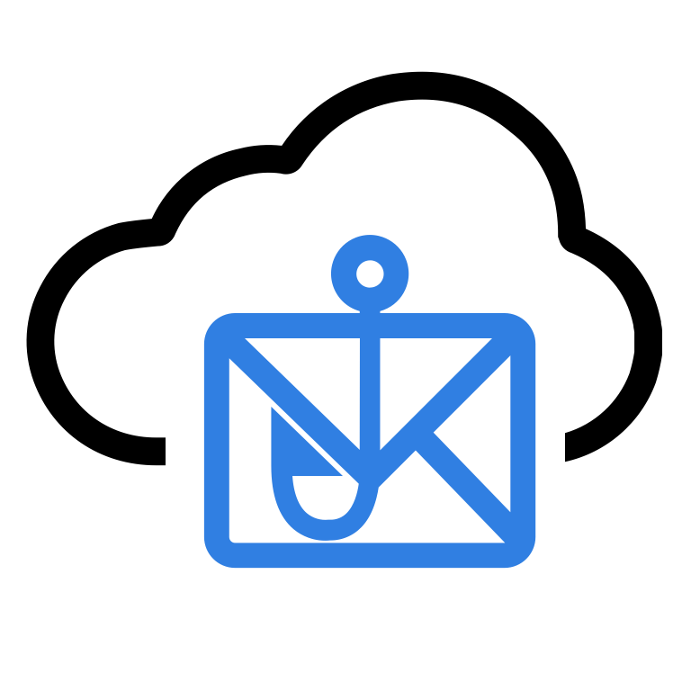
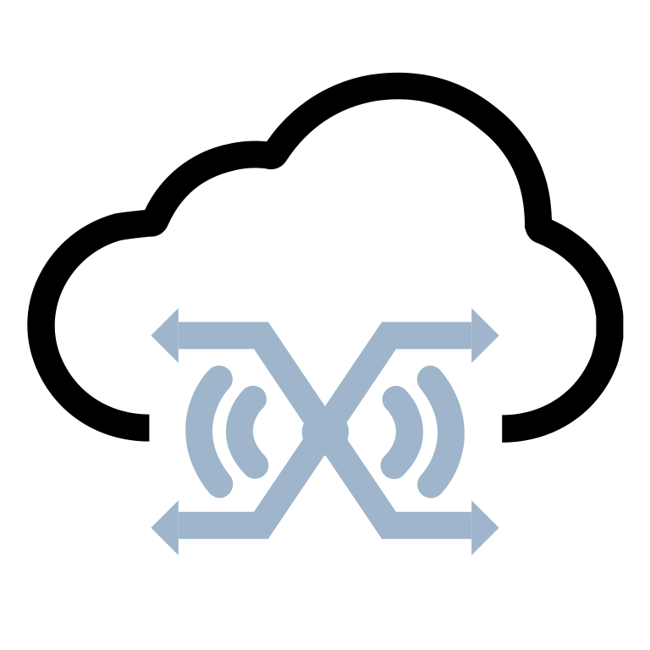
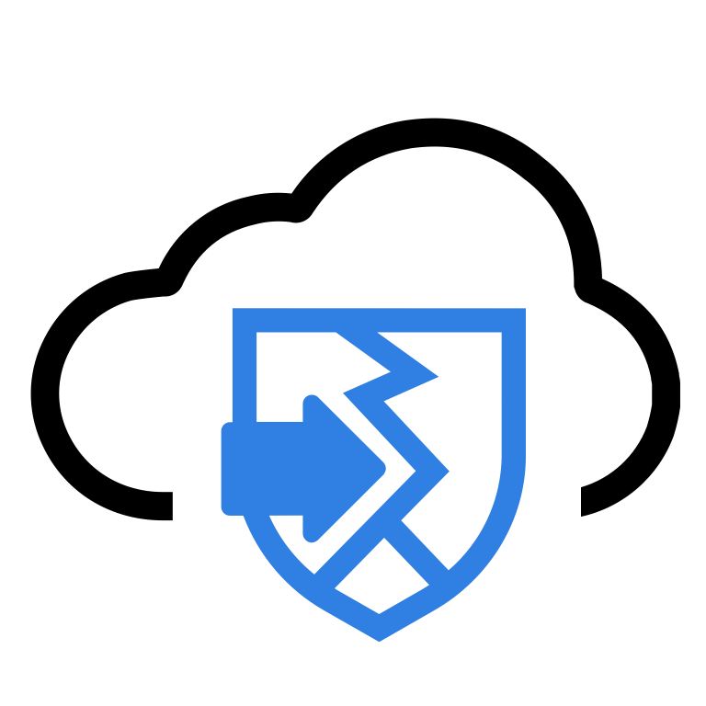



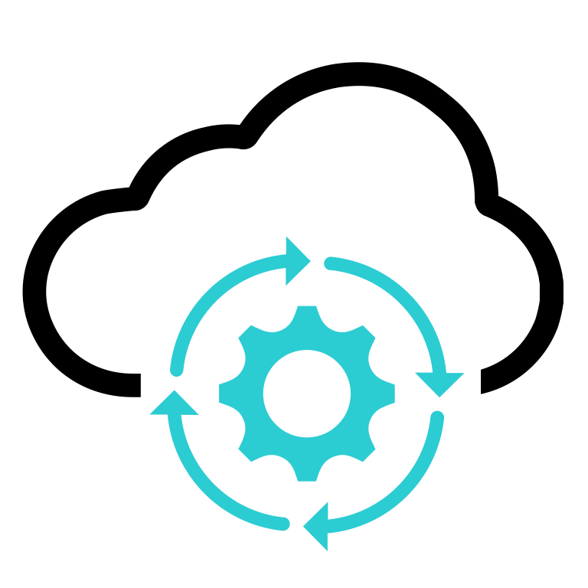
What’s next for SELECT MSSPs: FortiCloud Premium
Your up-sale platform to develop advanced MSSP Services
FortiCloud
Premium
Enables access to trial licences:
Develop Business
by proposing
free trials of new Services
FortiClient Cloud
FortiPhish Cloud
FortiLAN Cloud
FortiPenTest
FortiCloud
FortiExtender Cloud
FortiCNP
Premium
Free
for Select MSSPs
Enables access to management of:
Expand capabilities
to manage
advanced Services
FortiSandbox Cloud
FortiSOAR Cloud
Notes:
FortiCloud Premium unlocks capabilities that will help you develop advanced MSSP Services.
The most important is the capability to activate free trials, on-demand, for additional cloud-based SaaS services beyond FortiGate Cloud.
This is where the full strength of FortiCloud as a central management platform for all Fortinet SaaS services comes into play.
For example, you can activate free trials of:
FortiClient Cloud, which will enable you to easily deploy and manage FortiClient (trial limited to 3 Endpoints)
FortiPhish Cloud, a phishing simulation service providing regular testing against real-world simulated phishing threats,
to increase awareness of the risk posed by malicious emails and social engineering (trial limited to 30 mailboxes).
FortiPenTest, which runs a series of tests and attacks to determine what vulnerabilities a target IP address or Domain Name is susceptible to (trials for unlimited quick scan of 1 asset)
FortiCNP Cloud, a comprehensive Cloud security solution that helps identify and prioritize the most critical Cloud security issues, with actionable insights to help teams effectively manage cloud risk.
(trial for up to 100 Virtual Machines and 100 GB data)
FortiLAN Cloud, offering zero touch deployment, configuration management, reporting and analytics for standalone FortiAP and FortiSwitches deployments , when they are not downstream a FortiGate device (trial for 3 devices of each type)
FortiExtender Cloud, offering zero touch deployment, configuration management, reporting and analytics for standalone FortiExtender deployments, when they are not downstream a FortiGate device (trial for 3 FortiExtender devices)
It also unlocks the capability to manage advanced solutions (licenses for these solutions will still be required, it is only the management capability from FortiCloud that is unlocked):
FortiSandbox Cloud, which delivers Cloud-based sandbox rapid detection and automated response and provides unlimited flexibility to complement entry and mid-range FortiGates
FortiSOAR Cloud, a cloud-hosted Security Orchestration & Automated Response (SOAR) platform
[ click ]

Slide 30

Fortinet makes MSSP Easy!
Options and Steps forward: from the easiest to the most profitable
A
Test the MSSP Market
Your best option
to quickly test the MSSP market
Resell Fortinet Managed FortiGate Service
OPTION
+ No Upfront Investment
+ Immediately Actionable
Integrator
Delegate to Fortinet
Develop Managed Services as you Sell
Your MSSP Platform to manage FortiGate devices
Using FortiGate Cloud Management Platform
+ Small upfront Investment
+ Scalable Costs
You sold multiple Managed FortiGates
Your MSSP Management tool for scalability
Increase scalability with FortiCloud
+ Better Scalability
+ Time Saving
B
Develop additional Services
Your MSSP tool for Business Development
OPTION
Unlock Services &
Free Trials with FortiCloud Premium
Manage Services Yourself
+ Free Trials of Services
+ Advanced Services
Notes:
To summarize, the Premium version of FortiCloud is a powerful tool to support your business development to test trial and sell additional advance managed security services.
[ click ]

Slide 31

Summary
-
Benefits
for MSSPs
Simpler Operations
Scalability
& Flexibility
Better Customer
Experience
More
Profitability
Notes:
If we look back at the difficulties of “doing-it-yourself” presented at beginning of this Webinar, Fortinet helps you address them all :
1. Simplified Operations:
Fortinet provides a centralized platform for managing multiple customer deployments from a single interface.
It offers a unified view of Fortinet devices attached to the firewalls: switches, access points and FortiExtenders.
It streamlines management tasks, allowing MSSPs to efficiently oversee their customers' networks.
[ click ]
2. Scalability and Flexibility:
MSSPs can start small and expand their services as their customer base increases, without worrying about infrastructure limitations.
[ click ]
3. Better Customer Experience:
MSSPs can efficiently address customer needs, provide timely support, and ensure high levels of customer satisfaction.
[ click ]
4. More Profitability:
It eliminates the need for significant upfront investments in hardware or software infrastructure, reducing capital expenses.
Additionally, the cloud-based model eliminates the need for ongoing maintenance and hardware upgrades, reducing operational expenses for MSSPs, and increasing their capability to deliver a very profitable service.
[ click ]

Slide 32





What’s next for SELECT MSSPs: Fortinet MSSP Team Support
Take your MSSP ambitions to the next level with the Fortinet MSSP Team
Cybersecurity Company
in the World
Cybersecurity Company
in the World
Leading every evolution of cybersecurity
Assisting MSSPs
100% Channel &
dedicated team
Business mapping
Built on the power of
Fabric platform
Operational efficiency & sustainability
Flexible consumption
Notes:
This pathway to the MSSP market with Fortinet can get you a long way in your MSSP journey:
We have many examples of MSSP Partners who successfully manage very large number of Customers with several tens of thousands of devices … with just FortiCloud and FortiGate Cloud.
But it is not the end of your MSSP journey with Fortinet.
[ click ]
Those of you already on their way to Advanced and Expert levels, might already be thinking further ahead:
What about using the advanced capabilities of FortiManager Cloud or FortiAnalyzer Cloud to provide additional advanced services?
What about differentiating and increasing margins further by building your own SOC and Management Platform infrastructure?
At Fortinet, we have carrier-grade capabilities and expertise to support your highest ambitions in your MSSP journey.
We are recognized in the security industry not only for our leadership in Cybersecurity, but also for our leadership in assisting MSSPs on Cybersecurity.
This is a tribute to our dedication to Channel (Fortinet DNA is 100% Channel) and our investments to support and assist our MSSP Partners:
[ click ]
We have built a Team of dedicated MSSP Experts, who are there to help you succeed in your ambitions to go further and beyond.
This Team can help you make Business Mapping, develop opportunities with our Security Fabric, ramp up your operational capabilities, and deploy flexible Consumption Models
[ click ]

Slide 33
Bringing it all together!
Supporting Resources & Call To Action
Notes:
So, what are your next steps now?
[ click ]

Slide 34

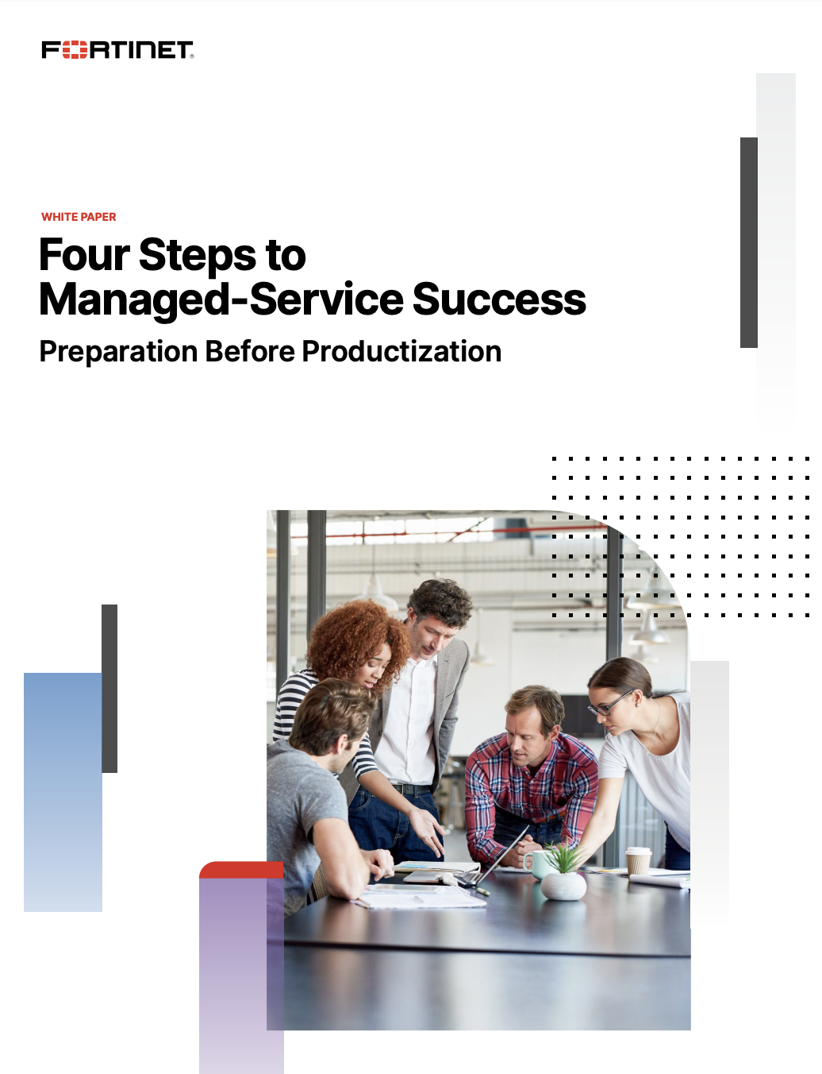
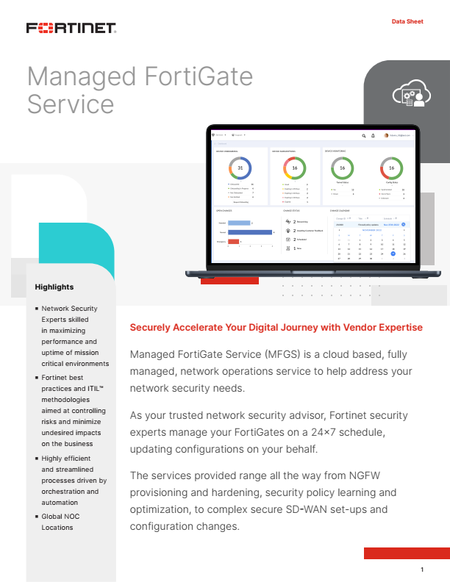
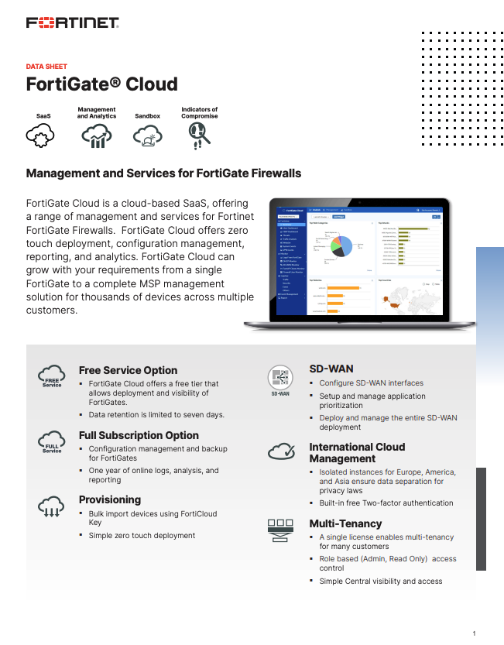
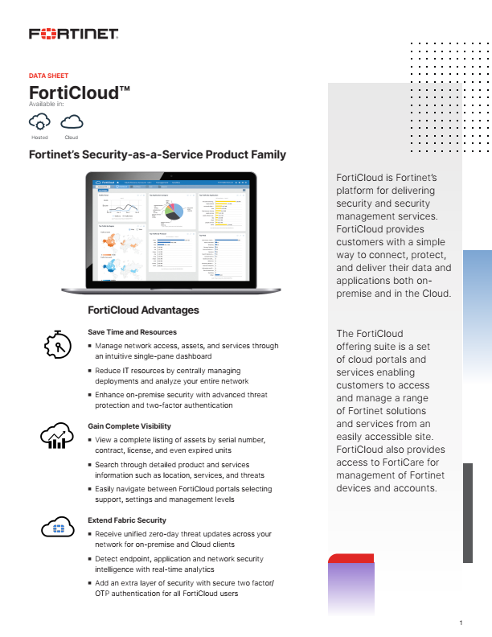
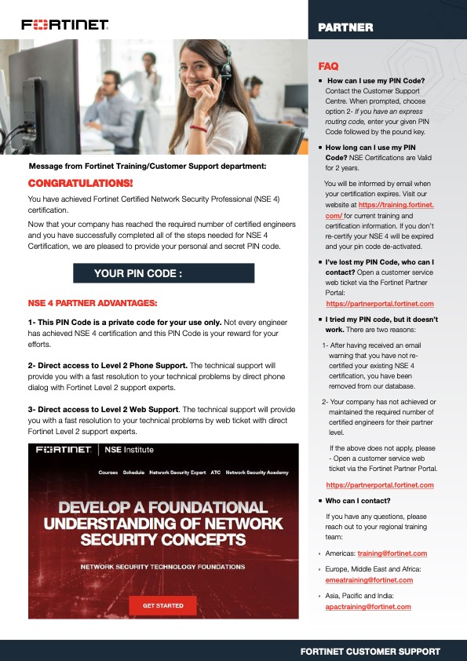
Supporting Resources
Managed Services Content
Best
Practices
Managed FortiGate
Service
FortiGate Cloud
FortiCloud
Direct Access to
Fortinet Support
White Paper
Data Sheet
Data Sheet
Data Sheet
Support Pin Overview
Notes:
Download these useful resources from our Web site, to get more information, starting with the “Four Steps to Managed-Service Success”: it provides valuable insights, best practices, and actionable tips to help you make the most of Fortinet's offerings.
[ click ]

Slide 35
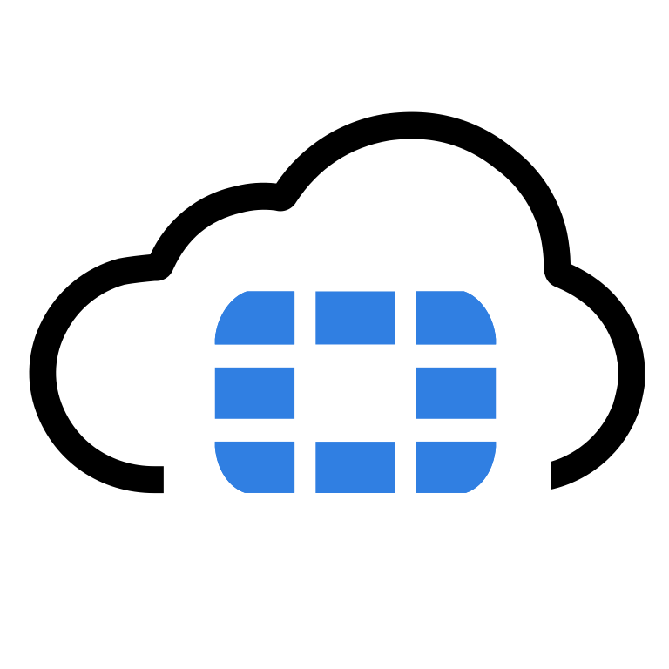

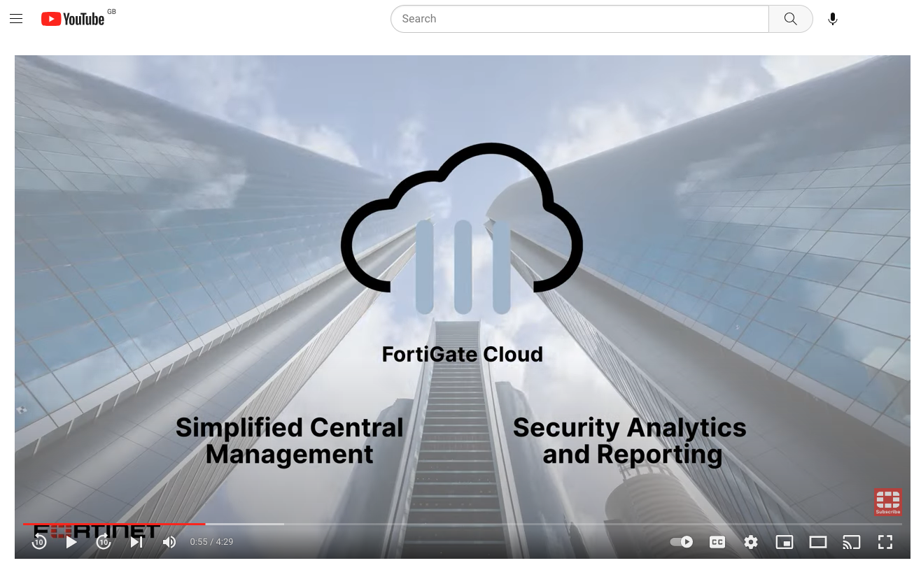
Management Platform
First Steps For An MSSP Using FortiCloud
Management Platform
Getting Started
Once you have the multi-tenant license registered it’s super easy to get your first devices set up and visible in sub-accounts in FortiGate Cloud, all possible in around 10 minutes.
FortiCloud Account Creation
Guide
FortiGate Cloud
Admin Guide
Admin Guide
  Log in to (or create) your FortiCloud account at www.forticloud.com
  Go to Services > FortiGate Cloud and create sub accounts for customers guide
  Assign user access to sub accounts guide
  Assign devices to sub accounts
FortiGate Cloud
Video
See the admin guide for more information to help with these steps.
Notes:
With a few easy steps, you can get started very quickly to harness the full power of FortiCloud and FortiGate Cloud.
You can create your FortiCloud account online with the link displayed here and get help from our FortiCloud video to get started in minutes.
Our Admin Guides will also teach you how to create new Accounts and Sub-Accounts to:
organize and manage your customers' assets to maintain a structured approach and streamline your operations …
… and to grant the proper access right levels to your team members, to collaborate efficiently and focus on delivering exceptional managed services
[ click ]
---------- ADDITIONAL NOTES TO THE PRESENTER --------------------------------------------
1. Log in to (or create) your FortiCloud account at www.forticloud.com: Access the FortiCloud platform to kickstart your journey.
If you're new to FortiCloud, sign up and create your account to gain access to its powerful features.
2 Go to Services > FortiGate Cloud and create sub accounts for customers: Take advantage of the sub accounts feature to organize and manage your customers' assets effectively.
Create separate accounts for each customer to maintain a structured approach.
3. Assign user access to sub accounts: Grant user access to specific sub accounts, ensuring that your team members have the right level of access and permissions.
This allows them to collaborate efficiently and focus on delivering exceptional managed services
4. Assign devices to sub accounts: Connect and assign the devices to the respective customer sub accounts. This ensures that each customer's assets are properly managed and monitored within FortiCloud, streamlining your operations.

Slide 36

What Can you Do?
Engage with your CAM or Distribution Representative
Adopt MSSP Business
Model
Get your
free FortiCloud Management
Platform
Develop your
Managed NGFW Offering
Notes:
Get started today and unlock new levels of efficiency and scalability!
Engage with your Fortinet or Distribution Account Manager: they will answer your questions and help you along the way.
Unlock the full benefits of being an MSSP by aligning your business in the Fortinet Engage program.
This will provide you with access to exclusive resources, support, and growth opportunities to propel your success in the managed security services market.
Get your free FortiCloud Management platform, and buy the multi-tenant subscription for FortiGate Cloud:
this will allow you to efficiently manage multiple customer environments, ensuring optimized security and performance
Follow our ”4 Steps to Get Started..." guide, which offers a step-by-step roadmap to kickstart your MSSP journey and start developing your own managed NextGen Firewall offering!
Don't wait any longer, get started today and take the first steps towards becoming a successful MSSP with Fortinet.
Thank you again for your commitment and your attention today: it is a pleasure to have you on this exciting journey.
Let's continue to explore the possibilities and build a thriving partnership together in the Managed Security Services market!
[ click ]

